Slide 1
Energy, pollution, and the climate crisis

Slide 2
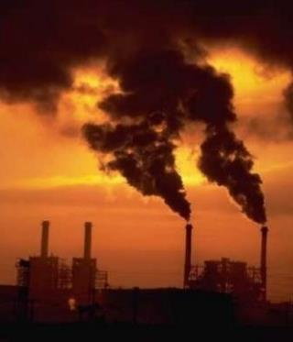
Energy and pollution
Notes:
A really significant source of environmental pollution is energy production – how we create electricity and fuels.
It’s quite important to recognize that there are no perfect energy sources – but there are ones that you can choose that are better for your health and the health of the planet.

Slide 3
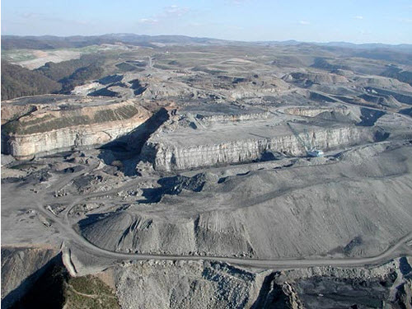
Consequences of using coal and oil
Very messy to extract, whether it be mountain-top removal for coal …
Notes:
The messiest method is mountain top removal, seen here. Coal seams are extracted from a mountain by removing the land, or overburden, above the seams. This method of coal mining is conducted in the Appalachian Mountains in the eastern United States, in Kentucky, West Virginia, Virginia, and Tennessee.
Explosives are used to remove up to 400 vertical feet of mountain to expose underlying coal seams. Excess rock and soil is dumped into nearby valleys.
Inevitably, streams are contaminated, groundwater is made undrinkable, the air is filled with coal dust, and flooding from denuded hillsides is increased
Local communities protest, but have very little recourse
https://www.christiansforthemountains.org/
Is God pleased when whole mountains and forests – with their wildlife – are destroyed?

Slide 4
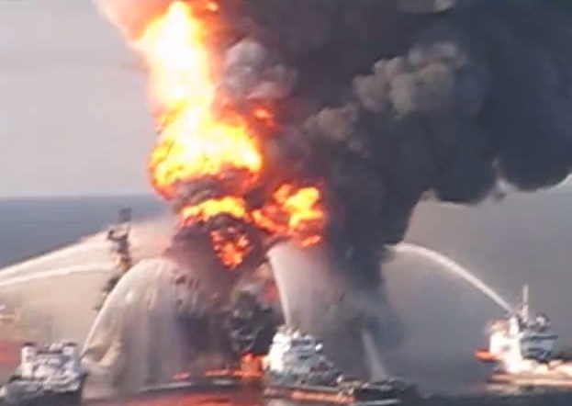
Consequences of using coal and oil
… seabed drilling for oil…
Notes:
This picture is of the Deepwater Horizon disaster. In April 2010, a natural gas leak was ignited, and the explosion killed 11 and injured 17.
The rig sank and there was an oil leak that lasted until July – the largest in history, creating a slick of over 57.500 square miles that polluted 1,100 miles of coastline.

Slide 5
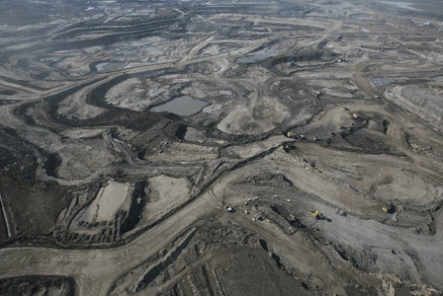
Consequences of using coal and oil
… or extracting oil from oil shale.
Notes:
Oil shale is, if you like, a deposit of oil/natural gas that isn’t quite mature. The most easily accessible reserves of oil shale are accessed via open cast mining. This emits on average three times more carbon dioxide than conventional oil extraction, not including the emissions resulting from deforestation. For every barrel of oil produced in this way at least 2 tonnes of material is mined. Some of these open cast mines are large enough to be seen from space. The small yellow dots in this image are in fact huge dumper trucks.

Slide 6
Consequences of using coal and oil
Inevitable carbon dioxide release
Power plants and automobile exhausts exacerbate asthma
Through hydrocarbons (fumes), nitrogen oxides, sulfur dioxide, and ozone
Soot (PM10s and smaller) - increased numbers of deaths due to heart disease
PM2.5 pollution associated with neurodegenerative disease
Burning coal for electricity is the primary source of atmospheric and water-borne mercury
Hence the problem with eating fish when pregnant
Notes:
Getting oil and coal out of the grounds is environmentally very ugly, as we have just seen.
Burning it – for electricity generation or propel a car – is equally nasty.
Combustion of anything carbon based releases carbon dioxide, CO₂, which as we will discover shortly, warms up the climate.
Ground-level smog makes breathing more difficult for asthmatics
“Particulate matter” smaller than 10 microns, especially two and a half microns in size and smaller, makes the heart work harder and even more worrying, seems associated with a higher risk of Parkinson’s and Alzheimer’s.
Coal contains quite large amounts of mercury - and so burning it is the prime source of mercury in the food chain.
Concerning PM2.5 pollution - - -
https://scienceofparkinsons.com/2020/10/22/pollution/
(quotes from this article)
PM2·5 particles can originate from different sources, such as motor vehicles, airplanes, power plants, residential wood burning, forest fires, volcanic eruptions, dust storms, etc). They are believed to be more troublesome because – being small and light – they tend to hang around longer in the air than their heavier siblings (like PM10).
Ok, so increases in annual PM2·5 concentrations was associated with a higher risk of Parkinson’s or Alzheimer’s?
Basically yes. The researchers found that for each defined amount of increase in PM2·5 levels (that amount being 5 μg/m3) in the course of a year, there was an increased risk of first hospital admission with Parkinson’s and Alzheimer’s.
Mercury – burning coal releases mercury which enters the food chain via microorganisms converting it to methylmercury. As these organisms are consumed by small fish, which are in turn eaten by bigger fish, then ultimately, us, there is a massive concentration of the mercury compounds (a swordfish or tuna is found to have tissue concentrations of mercury one million times higher than the concentration in the water they are swimming in.)
Mercury, eaten at these levels, is dangerous to a developing baby if the mother eats enough such fish.

Slide 7
Using other energy sources
Methane/propane: fairly clean; carbon dioxide released
Nuclear and hydroelectric: good and bad
Solar, wind power: improving but not perfect
Others:
Wave power
Geothermal
The CLEANEST energy is the energy you DON’T USE
Because no energy source is ideal
Notes:
Other energy sources are a mixed bag.
Burning gas such as methane (natural gas) and propane is pretty clean but still of course makes carbon dioxide
Nuclear power does not directly generate carbon dioxide and can be fantastically efficient in terms of how much mining is needed to produce the uranium. But building costs and waste storage costs are high.
Hydroelectric power (from dams) again does not directly generate carbon dioxide but has a very destructive environmental footprint (drowning trees, blocking free movement of fish, very high CO₂ generation making concrete)
The technologies behind solar and wind power are improving, but battery storage and networks are needed.
Geothermal and wave power, although very ‘niche’, have good potential.
…. But conservation is the best option.

Slide 8
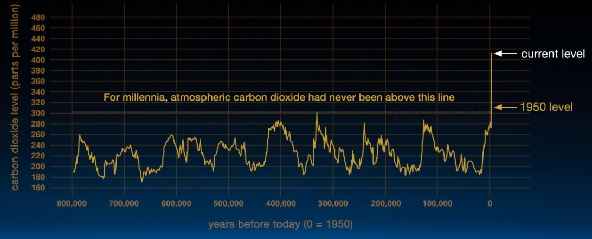
Climate Change 101

Slide 9
What does Laudato Si’ say?
‘The climate is a common good, belonging to all and meant for all. At the global level, it is a complex system linked to many of the essential conditions for human life’
‘A very solid scientific consensus indicates that we are presently witnessing a disturbing warming of the climatic system …’ (Laudato Si’, #23)
Notes:
#23 - 24, Chapter One of Laudato Si encyclical
In just two paragraphs, the Holy Father summarizes the facts and the consequences of the accumulation of greenhouse gases (primarily carbon dioxide but also methane, hydrofluorocarbons, nitrous oxide and others). Please take the time to read the paragraphs (23 and 24) for yourself.

Slide 10
What does Laudato Si’ say?
‘The melting in the polar ice caps and in high altitude plains can lead to the dangerous release of methane gas … Things are made worse by the loss of tropical forests which would otherwise help to mitigate climate change.’
‘Carbon dioxide pollution increases the acidification of the oceans and compromises the marine food chain.’ (Laudato Si’, #24)
Notes:
#23 - 24, Chapter One of Laudato Si encyclical
In just two paragraphs, the Holy Father summarizes the facts and the consequences of the accumulation of greenhouse gases (primarily carbon dioxide but also methane, hydrofluorocarbons, nitrous oxide and others). Please take the time to read the paragraphs (23 and 24) for yourself.

Slide 11
What does Laudato Si’ say?
‘If present trends continue, this century may well witness extraordinary climate change and an unprecedented destruction of ecosystems, with serious consequences for all of us.’
‘A rise in the sea level, for example, can create extremely serious situations, if we consider that a quarter of the world’s population lives on the coast or nearby, and that the majority of our megacities are situated in coastal areas.’ (Laudato Si’, #24)
Notes:
#23 - 24, Chapter One of Laudato Si encyclical
In just two paragraphs, the Holy Father summarizes the facts and the consequences of the accumulation of greenhouse gases (primarily carbon dioxide but also methane, hydrofluorocarbons, nitrous oxide and others). Please take the time to read the paragraphs (23 and 24) for yourself.

Slide 12
The poor will suffer the most
‘Climate change is a global problem with grave implications: environmental, social, economic, political and for the distribution of goods.’
‘It represents one of the principal challenges facing humanity in our day.’
‘Its worst impact will probably be felt by developing countries in coming decades.’ (Laudato Si’, #25)
Notes:
#25

Slide 13
The poor will suffer the most
‘Many of the poor live in areas particularly affected by [warming], and [they] … are largely dependent on natural reserves …such as agriculture, fishing and forestry.’
‘They have no other financial activities or resources which can enable them to adapt to climate change or to face natural disasters, and their access to social services and protection is very limited.’ (Laudato Si’, #25)
Notes:
#25

Slide 14
Where is climate change coming from?
We are digging up ‘fossil’ carbon and burning it, injecting a significant amount of new carbon dioxide (CO₂) into the atmosphere
About half the extra CO₂ has been taken up by the oceans, soil and plants and the rest is staying in the air
The CO₂ atmospheric level has risen substantially since the beginning of the industrial era
Now, at 410 ppm, the highest for 800,000 years
Notes:
Climate Change Indicators in the United States | US EPA
Global-average CO2 concentrations have been observed to increase from levels of around 280 parts per million (ppm) in the mid-19th century to 421 ppm by May 2022. CO2 concentrations can be measured in “ancient air” trapped in bubbles in ice, deep below the surface in Antarctica and Greenland; these show that present-day concentrations are higher than any that have been observed in the past 800,000 years, when CO2 varied between about 180 and 300 ppm. Various lines of evidence point strongly to human activity being the main reason for the recent increase, mainly due to the burning of fossil fuels (coal, oil, gas) with smaller contributions from land-use changes and cement manufacture. The evidence includes the consistency between calculations of the emitted CO2 and that expected to have accumulated in the atmosphere, the analysis of the proportions of different CO2 isotopes, and the amount of oxygen in the air.
These observations show that about half of the CO2 emitted by human activity since the industrial revolution has remained in the atmosphere. The remainder has been taken up by the oceans, soils and plants although the exact amount going to each of these individually is less well known.
Royal Society
June 8, 2021: 419.13 ppm in May 2021, which is 1.82 ppm more than a year before.
May 2022 – 421 ppm

Slide 15
Where is climate change coming from?
We are digging up ‘fossil’ carbon and burning it, injecting a significant amount of new carbon dioxide (CO₂) into the atmosphere
About half the extra CO₂ has been taken up by the oceans, soil and plants and the rest is staying in the air
The CO₂ atmospheric level has risen substantially since the beginning of the industrial era
Now, at 410 ppm, the highest for 800,000 years
420

Slide 16
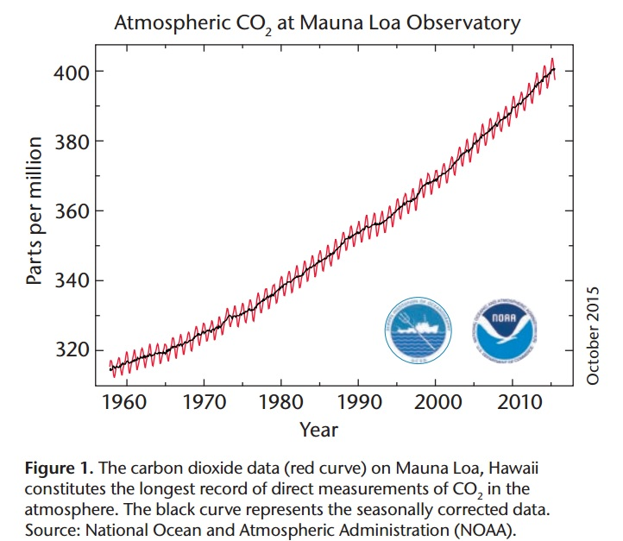
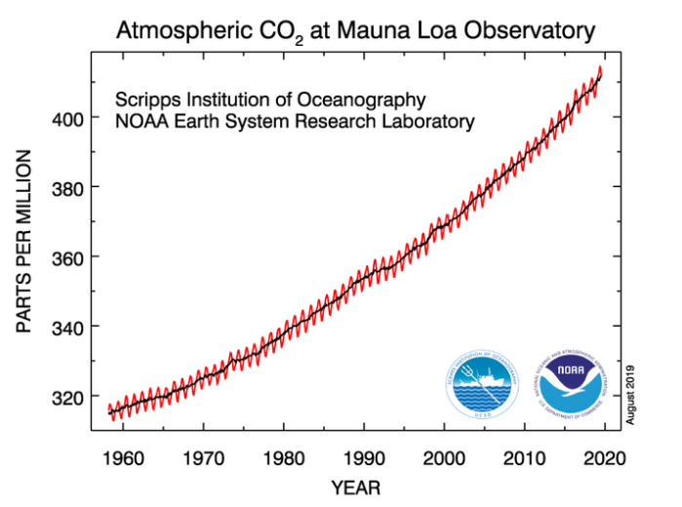
Greenhouse gas emissions
Notes:
https://www.metoffice.gov.uk/weather/climate-change/what-is-climate-change
Global Monitoring Laboratory - Carbon Cycle Greenhouse Gases (noaa.gov) (https://www.esrl.noaa.gov/gmd/ccgg/trends/)
April 18th, 2017 – 410 ppm
CO2 levels rose by 2.6 ppm in 2019, faster than the average rate for the last ten years, which was 2.37 ppm, and are now 48 per cent higher than the pre-industrial level. Carbon dioxide levels hit new record; COVID impact ‘a tiny blip’, WMO says | | UN News
May 13, 2022 – 420 ppm

Slide 17
Greenhouse gas emissions
Notes:
https://climate.nasa.gov/evidence/
The heat-trapping nature of carbon dioxide and other gases was demonstrated in the mid-19th century. Their ability to affect the transfer of infrared energy through the atmosphere is the scientific basis of many instruments flown by NASA. There is no question that increased levels of greenhouse gases must cause Earth to warm in response.
Ice cores drawn from Greenland, Antarctica, and tropical mountain glaciers show that Earth’s climate responds to changes in greenhouse gas levels. Ancient evidence can also be found in tree rings, ocean sediments, coral reefs, and layers of sedimentary rocks. This ancient, or paleoclimate, evidence reveals that current warming is occurring roughly ten times faster than the average rate of ice-age-recovery warming. Carbon dioxide from human activity is increasing more than 250 times faster than it did from natural sources after the last Ice Age.
Earth-orbiting satellites and other technological advances have enabled scientists to see the big picture, collecting many different types of information about our planet and its climate on a global scale. This body of data, collected over many years, reveals the signals of a changing climate.

Slide 18
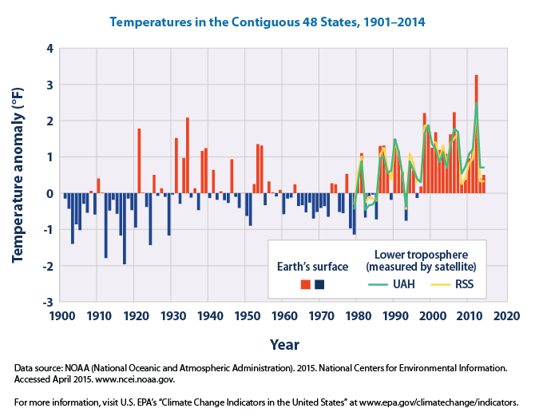
Climate Change
Notes:
https://www3.epa.gov/climatechange/science/indicators/weather-climate/temperature.html
This figure shows how annual average temperatures in the lower 48 states have changed since 1901.
The red and blue are surface data coming from land-based weather stations
The green and yellow present two different ways of analyzing satellite measurements (temperature of the lower troposphere, which is the lowest level of the Earth’s atmosphere. “UAH” and “RSS” represent two different methods of analyzing the original satellite measurements.)
This graph uses the 1901–2000 average as a baseline for depicting change. Choosing a different baseline period would not change the shape of the data over time.
Climate Change Indicators in the United States | US EPA
Average temperatures have risen across the lower 48 states since 1901, with an increased rate of warming over the past 30 years
Seven of the top 10 warmest years on record for the lower 48 states have occurred since 1990
Most of the warming occurred in the past 40 years, and the past seven years have been the warmest on record (World Meteorological Association)
https://climate.nasa.gov/evidence/

Slide 19
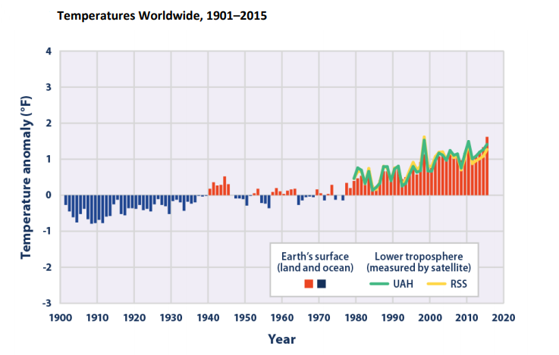
Climate Change
Notes:
https://www3.epa.gov/climatechange/science/indicators/weather-climate/temperature.html
This figure shows how annual average temperatures worldwide have changed since 1901. Surface data come from a combined set of land-based weather stations and sea surface temperature measurements. Satellite measurements cover the lower troposphere, which is the lowest level of the Earth’s atmosphere. “UAH” and “RSS” represent two different methods of analyzing the original satellite measurements. This graph uses the 1901–2000 average as a baseline for depicting change. Choosing a different baseline period would not change the shape of the data over time.
2 NOAA (National Oceanic and Atmospheric Administration). 2016. National Centers for Environmental Information. Accessed February 2016. www.ncei.noaa.gov.

Slide 20
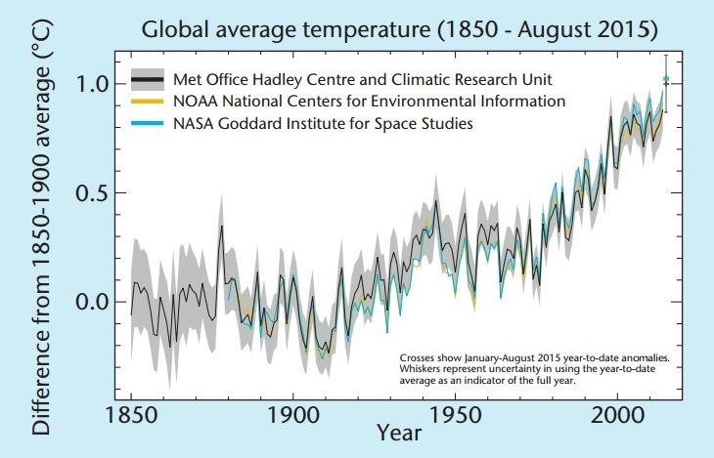
Global Temperature Changes
Notes:
http://www.metoffice.gov.uk/climate-change/guide/how
To understand changes and variations in our climate it is essential to know how the surface temperature changes — from month to month, up to decade to decade. Global-average temperature records provide this vital information.
From these records we can see how warm specific months, years or decades are, and we can discern trends in our climate over longer periods of time. Global records go back about 160 years, giving a long period from which to draw conclusions about how our climate is changing.
There are three centers which calculate global-average temperature each month.
Met Office, in collaboration with the Climatic Research Unit (CRU) at the University of East Anglia (UK)
Goddard Institute for Space Studies (GISS), which is part of NASA (USA)
National Climatic Data Center (NCDC), which is part of the National Oceanic and Atmospheric Administration (NOAA) (USA)
These work independently and use different methods in the way they collect and process data to calculate the global-average temperature. Despite this, the results of each are similar from month to month and year to year, and there is definite agreement on temperature trends from decade to decade (Figure 1). Most importantly, they all agree global-average temperature has increased over the past century and this warming has been particularly rapid since the 1970s.
NOAA and NASA use different analyses: the former places 2017 as the third warmest year on record, after 2015 and 2016; NASA’s data indicate 2017 as the second warmest, after 2016. NOAA found the average global temperature as 0.84 deg. C higher than the twentieth century mean. NASA compared the 2017 data with a reference average from 1951-1980, and found its mean to be 0.9 deg. C. higher.
http://www.metoffice.gov.uk/climate-guide
http://www.metoffice.gov.uk/media/pdf/4/b/Our_changing_climate_-_the_current_science.pdf

Slide 21
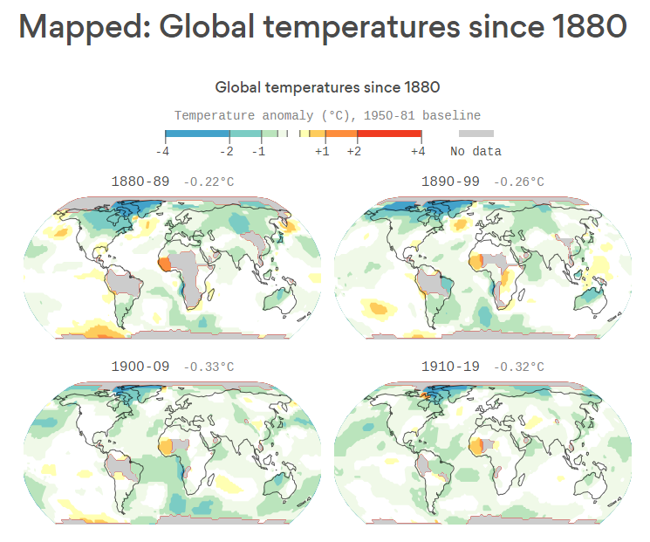
Climate Change
Notes:
Every area of the globe has warmed since instrument records began in 1880, NASA data shows. The planet isn't warming equally, however — the fastest temperature increases are taking place at the poles. The Arctic, for example, is warming at more than twice the rate of the rest of the globe, melting sea ice, glaciers and permafrost.
The bottom line: Due largely to human emissions of greenhouse gases, there is virtually no such thing as a cooler than average year on Earth anymore. (The last cooler-than-average month was 30 years ago, in December 1984).
"The globe is warming. There’s noise in each month or year but by the time you are looking at decadal means that part is small and the trends undeniable," said Gavin Schmidt, the director of NASA's Goddard Institute for Space Studies.
https://www.axios.com/how-much-the-world-has-warmed-since-1880-9fcf1bcb-38d4-4bff-8dc8-10fde9f4c895.html
https://data.giss.nasa.gov/gistemp/maps/

Slide 22
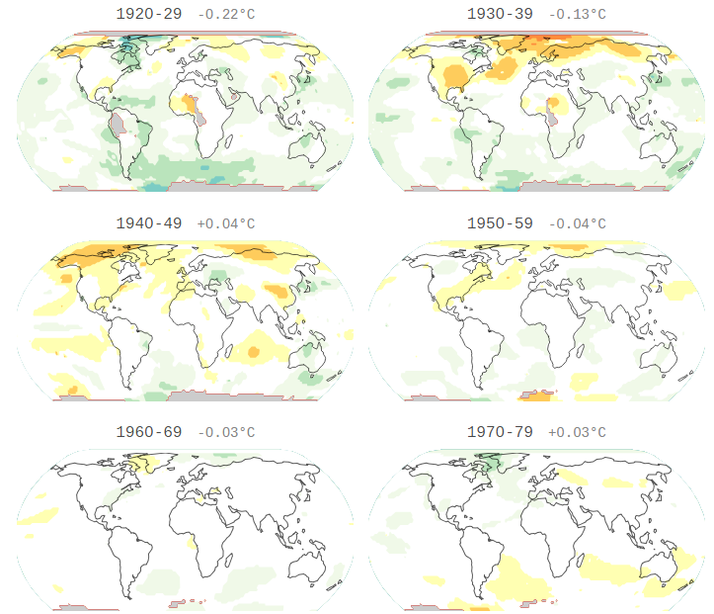
Climate Change
Notes:
Every area of the globe has warmed since instrument records began in 1880, NASA data shows. The planet isn't warming equally, however — the fastest temperature increases are taking place at the poles. The Arctic, for example, is warming at more than twice the rate of the rest of the globe, melting sea ice, glaciers and permafrost.
The bottom line: Due largely to human emissions of greenhouse gases, there is virtually no such thing as a cooler than average year on Earth anymore. (The last cooler-than-average month was 30 years ago, in December 1984).
"The globe is warming. There’s noise in each month or year but by the time you are looking at decadal means that part is small and the trends undeniable," said Gavin Schmidt, the director of NASA's Goddard Institute for Space Studies.
https://www.axios.com/how-much-the-world-has-warmed-since-1880-9fcf1bcb-38d4-4bff-8dc8-10fde9f4c895.html
https://data.giss.nasa.gov/gistemp/maps/

Slide 23
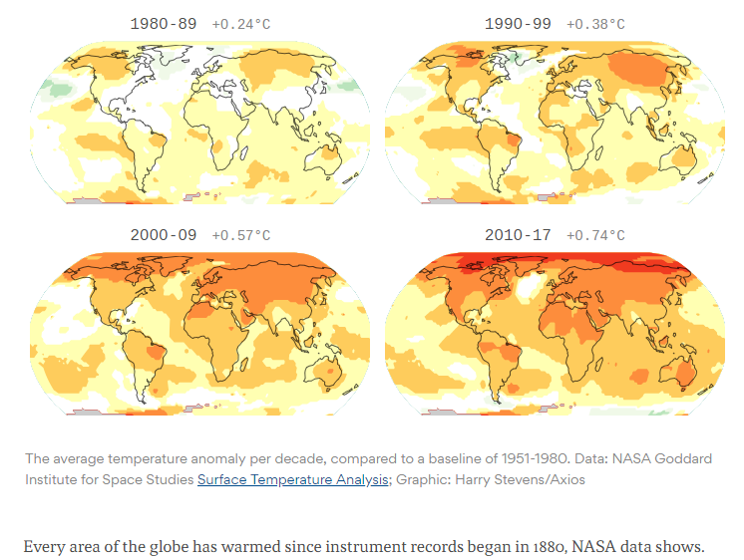
Climate Change
Notes:
Every area of the globe has warmed since instrument records began in 1880, NASA data shows. The planet isn't warming equally, however — the fastest temperature increases are taking place at the poles. The Arctic, for example, is warming at more than twice the rate of the rest of the globe, melting sea ice, glaciers and permafrost.
The bottom line: Due largely to human emissions of greenhouse gases, there is virtually no such thing as a cooler than average year on Earth anymore. (The last cooler-than-average month was 30 years ago, in December 1984).
"The globe is warming. There’s noise in each month or year but by the time you are looking at decadal means that part is small and the trends undeniable," said Gavin Schmidt, the director of NASA's Goddard Institute for Space Studies.
https://www.axios.com/how-much-the-world-has-warmed-since-1880-9fcf1bcb-38d4-4bff-8dc8-10fde9f4c895.html
https://data.giss.nasa.gov/gistemp/maps/

Slide 24
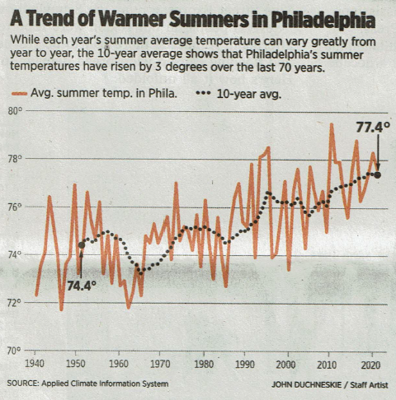
Philadelphia summers
Notes:
Philadelphia Inquirer September 5, 2021

Slide 25
Climate Change Revealed by Nature
Spring is starting earlier and there is a delayed onset of autumn/winter
Birds are appearing earlier in the year
UK swallows arrive 15 days earlier in 2017 vs 1960s
UK Sand Martins arrive 23 days earlier
Plants are flowering earlier
English Oak leafs out a month earlier now vs 1950
Predators vs prey becoming out-of-synch
Notes:
Nature isn’t biased. All the signs point to a warming Earth.
BBC Wildlife April 2017 – average British spring temperature: 7.1 deg C 1961-1990; 7.7 deg C 1981-2010; 8.1 deg C 2006-2015. Sand martins arrive 23 days earlier (2000s vs 1960s). Past 70 years – English oak leafs out in early April now, used to be early May.
State of the UK Birds 2017: swallows now return 15 days earlier than in the 1960s.
Predatory birds, fish and mammals are much less sensitive to temperature – arriving back too late for caterpillar peak etc. (plants flowering/leafing 10 days earlier, insects emerging 2 weeks earlier, birds migrating/breeding only 1 week earlier (2016 vs 2001.
The average length of the growing season in the lower 48 states has increased by about two weeks since the beginning of the 20th century
A particularly large and steady increase has occurred over the last 30 years
The observed changes reflect earlier spring warming as well as later arrival of fall frosts
The length of the growing season has increased more rapidly in the West than in the East
http://www.metoffice.gov.uk/climate-change/guide/how

Slide 26
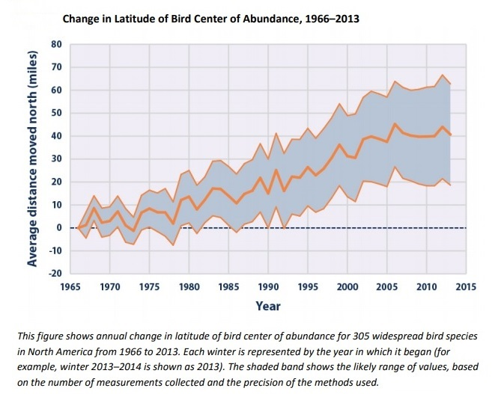
Christmas Bird Count (Audubon)
Notes:
Bird Wintering Ranges (epa.gov)
https://www.epa.gov/sites/production/files/2016-08/documents/print_bird-ranges-2016.pdf
https://birds.audubon.org/sites/default/files/documents/birds_and_climate_report.pdf
Among 305 widespread North American bird species, the average mid-December to early January center of abundance moved northward by more than 40 miles between 1966 and 2013.
Trends in the center of abundance moving northward can be closely related to increasing winter temperatures.
61% moved north, 27% south, the rest stayed loyal to their wintering place
On average, bird species have also moved their wintering grounds farther from the coast since the 1960s.
Related to changes in winter temperatures. Inland areas tend to experience more extreme cold than coastal areas, but those extremes are becoming less severe as the climate warms overall.
For year-to-year consistency, this indicator uses observations from the National Audubon Society’s Christmas Bird Count which is a well curated set of data about what birds are seen in a defined area on a particular weekend in December.
which takes place every year in early winter. The Christmas Bird Count is a longrunning citizen-science program in which individuals are organized by the National Audubon Society, Bird Studies Canada, local Audubon chapters, and other bird clubs to identify and count bird species. The data presented in this indicator were collected from more than 2,000 locations throughout the United States and parts of Canada. At each location, skilled observers follow a standard counting procedure to estimate the number of birds within a 15-mile diameter “count circle” over a 24-hour period. Study methods remain generally consistent from year to year. Data produced by the Christmas Bird Count go through several levels of review before Audubon scientists analyze the final data, which have been used to support a wide variety of peer-reviewed studies.

Slide 27
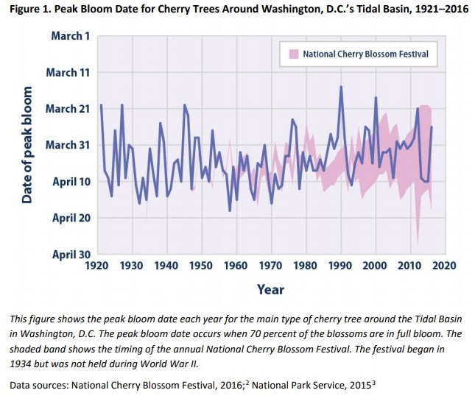
Washington DC Cherry Blossom
Notes:
Community Connection: Cherry Blossom Bloom Dates in Washington, D.C. (epa.gov)
IN 1912, we were given 3,000 cherry trees by the Japanese as a gesture of friendship. The beautiful blooms set against the backdrop of the national monuments bring more than 1.5 million visitors to the area every year during the National Cherry Blossom Festival. Not surprisingly, the festival is planned to coincide with the peak bloom of the cherry trees.
The exact timing of peak bloom varies from year to year, and it is largely driven by local temperatures during the winter and early spring. As the Leaf and Bloom Dates indicator explains, scientists have very high confidence that recent warming trends in global climate are causing spring events such as leaf growth and flower blooms to happen earlier.1 In the case of Washington’s cherry blossoms, earlier bloom dates could affect tourism and the local economy. The peak bloom date for the most common type of cherry tree around Washington’s Tidal Basin—the Yoshino variety—has been carefully estimated and recorded since 1921 by the National Park Service. The peak bloom date is defined as the day when 70 percent of the blossoms are in full bloom.
Based on the entire 96 years of datapeak bloom date for the cherry trees is occurring earlier than it did in the past. Since 1921, peak bloom dates have shifted earlier by approximately five days.
While the length of the National Cherry Blossom Festival has continued to expand, the Yoshino cherry trees have bloomed near the beginning of the festival in recent years. During some years, the festival missed the peak bloom date entirely.

Slide 28
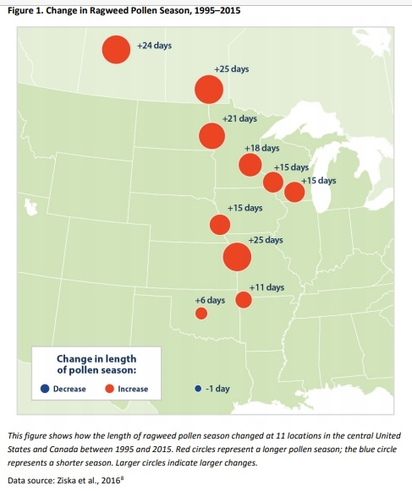
Ragweed Pollen Season
Notes:
Ragweed Pollen Season (epa.gov)
Allergies are a major public health concern, with hay fever (congestion, runny nose, itchy eyes) accounting for more than 13 million visits to physicians’ offices and other medical facilities every year. One of the most common environmental allergens is ragweed, which can cause hay fever and trigger asthma attacks, especially in children and the elderly. An estimated 16 percent of all Americans are sensitive to ragweed. Ragweed plants mature in mid-summer and produce small flowers that generate pollen. Ragweed pollen season usually peaks in late summer and early fall, but these plants often continue to produce pollen until the first frost. A single ragweed plant can produce up to a billion pollen grains in one season, and these grains can be carried long distances by the wind.
Climate change can affect pollen allergies in several ways. Warmer spring temperatures cause some plants to start producing pollen earlier (see the Leaf and Bloom Dates indicator), while warmer fall temperatures extend the growing season for other plants, such as ragweed (see the Length of Growing Season indicator).
Since 1995, ragweed pollen season has grown longer at 10 of the 11 locations studied.
The increase in ragweed season length generally becomes more pronounced from south to north. This trend is consistent with many other observations showing that climate is changing more rapidly at higher latitudes.
The trends are strongly related to changes in the length of the frost-free season and the timing of the first fall frost.
Northern areas have seen fall frosts happening later than they used to, with the delay in first frost closely matching the increase in pollen season. Meanwhile, some southern stations have experienced only a modest change in frost-free season length since 1995.
Warmer temperatures and increased carbon dioxide concentrations also enable ragweed and other plants to produce more allergenic pollen, in larger quantities. This means that many locations could experience longer allergy seasons and higher pollen counts as a result of climate change.

Slide 29
Carbon dioxide and the oceans
Notes:
Although the ocean’s ability to take up carbon dioxide is a positive attribute with respect to mitigating climate change, these reactions can have a negative effect on marine life. Carbon dioxide from the atmosphere reacts with sea water to produce carbonic acid.
Increasing acidity (measured by lower pH values) reduces the availability of chemicals needed to make calcium carbonate, which corals, some types of plankton, and
other creatures rely on to produce their hard skeletons and shells. The effect of declining pH on shell-producing ocean organisms can
cause changes in overall ecosystem structure in coastal ecosystems.
https://www.economist.com/films/2023/02/02/the-threat-of-ocean-acidification

Slide 30
Warming the seas
Warmer oceans have knock-on effects on weather, fisheries, and more

Slide 31
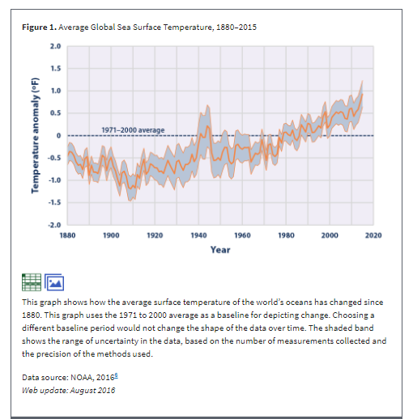
Notes:
Sea temperatures are going up.
https://www.epa.gov/climate-indicators/climate-change-indicators-sea-surface-temperature
https://climate.nasa.gov/evidence/

Slide 32
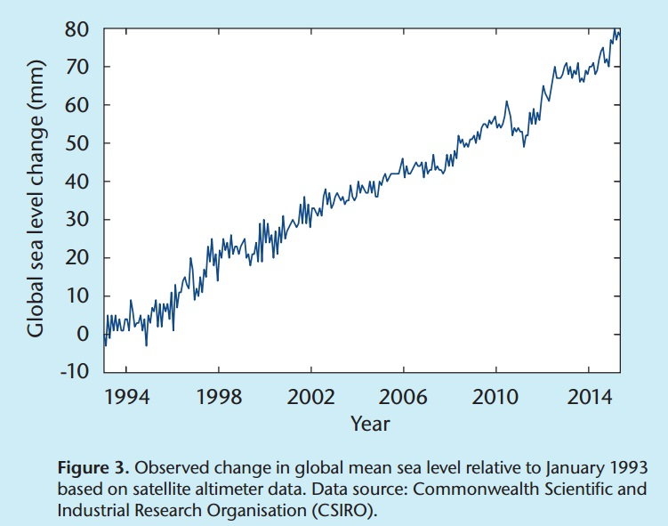
Sea level changes
Notes:
Climate monitoring and attribution - Met Office
https://www.metoffice.gov.uk/research/climate/climate-monitoring/index
Global sea levels have risen by around 1.7 mm per year over the last century and increasing to 3.2 mm per year since around the early 1990s. Our understanding of the components of sea-level rise has improved significantly over recent years, with the main contributors being thermal expansion (oceans expanding as they warm) and melting of glaciers.
‘A rise in the sea level, for example, can create extremely serious situations, if we consider that a quarter of the world’s population lives on the coast or nearby, and that the majority of our megacities are situated in coastal areas.’ (Laudato Si’, #24)
http://www.cmar.csiro.au/sealevel/sl_hist_last_decades.html

Slide 33
Climate, weather
Although we’ve always had hurricanes and fires …
A warming ocean is guaranteed to rev up a hurricane
Climate change and invasive pest species are leading to more and more dangerous fires in Western forests
Similar events in Europe, Siberia
Notes:
Basic physics/common sense will tell you that a hurricane going over warmer water absorbs heat and thus becomes more powerful.
More hot, dry air and less rain accentuate the fire risk in the West.
https://blogs.ei.columbia.edu/2014/10/13/what-do-wildfires-have-to-do-with-climate-change/#:~:text=Wildfires%2C%20which%20are%20intensified%20by%20global%20warming%2C%20also,soil%20into%20the%20atmosphere%2C%20trapping%20ever%20more%20heat.
Average annual temperatures in the western U.S. have risen 1.9˚F since 1970 and are expected to climb 2.5˚F to 6.5˚F by 2050. According to a 2011 study by the National Academies, even 1.8˚F of warming will dramatically increase the average area burned every year in the western U.S.
“As it gets warmer, the area burned increases exponentially as a function of temperature,” explained Park Williams, an assistant research professor at Lamont-Doherty Earth Observatory who studies the effect temperature has on drought. His research has shown that small changes in temperature result in large changes in the atmosphere’s “sponginess.”
“As the temperature rises, the ability of the atmosphere to pull water out of the ecosystem goes up exponentially,” said Williams. For the past 15 years, the atmosphere’s ability to pull water out of the ecosystem has been 12 percent higher than its 120-year average.
Climate models project that by 2050, burned areas will increase 60 percent and the fire season will last 23 days longer. “Based on what we’ve seen in the last 30 years, we will see increased wildfire activity as long as fuels are available,” said Williams. “But at some point, forests will become so fragmented because of wildfires, that we will no longer see increases in the size of wildfires.”
https://www.sciline.org/quick-facts/wildfires-climate-change
In the western United States^{i} human-caused climate change caused more than half the increase in forest fuel aridity (how dry and flammable vegetation is) since the 1970s and has approximately doubled the cumulative area burned in forest fires since 1984.¹
Climate-change-related declines in western spring snowpack, and increased evaporation from higher temperatures in spring, summer, and fall, have in the decades since the early 1980s reduced moisture and contributed to a marked increase in the frequency of large fires and the total area burned by western wildfires.²
From 1972 to 2018, there was an eight-fold increase in the annual area burned in California’s summertime forest fires. Evidence suggests that this dramatic increase was caused primarily by unusually dry air linked to human-caused climate change.³
Earlier spring snowmelt and other factors related to human-caused climate change have contributed to a substantial increase in fire season^{ii} length in forests throughout the western United States. Western U.S. fire seasons in 2003–2012 averaged more than 84 days longer than in 1973–1982. The average burn time of the largest wildfires also increased during this period, from nearly six days to more than 50 days.⁴
Nights have warmed significantly—even more than days—during the U.S. fire season. That added heat has lowered the overnight relative humidity that once gave firefighters some of their best opportunities to gain control over wildfires.
Warming has been especially dramatic at higher latitudes.⁵ In Alaska, a state that already suffered severe wildfires early in 2019, the average overnight low temperature in July 2019 was the hottest since record-keeping began in 1925.⁶
The frequency and intensity of wildfires in Alaska have been greater in the past few decades than for any period in the past 10,000 years.⁷
A study of Rocky Mountain wildfire-prone areas found that moisture levels were lower in the 15 years after 2000 than in the 15 years before 2000—a “moisture deficit” that correlates with a post-2000 decline in tree seedling densities and forest regeneration.⁸ A study of western U.S. ponderosa pine and Douglas fir forests concluded that climate-change-related moisture deficits are undermining post-wildfire forest regeneration and recovery there.⁹
Wildfire “smoke waves” impose a significant health burden on millions of people in western U.S. states. During the 2004 to 2009 fire seasons, in the western U.S. counties where wildfires are frequent, wildfires were responsible for more than 70 percent of the air pollution on days when fine particulate matter in the air surpassed regulatory limits.¹⁰
Despite widespread improvements in air quality across the United States in recent decades, air quality during the summer has declined across much of the Northwest as a consequence of increased wildfire activity.¹¹
1. Abatzoglou, J.T. and Williams, Park, (2016), Impact of anthropogenic climate change on wildfire across western U.S. forests, PNAS, 113, (42), 11770-11775 2. Westerling, A.L., et al., (2016) Warming and earlier spring increase western U.S. forest wildfire activity, Science, 313, 5789, 940-943 3. Williams, A.P., et al., (2019), Observed impacts of anthropogenic climate change on wildfire in California, Earth’s Future, 7 4. Westerling, A.L., (2016), Increasing western US forest wildfire activity: sensitivity to changes in the timing of spring, Philosophical Transactions of the Royal Society B: Biological Sciences, 371, (1696), 20150178 5. National Park Service, (2019), Alaska Nature and Science: High-latitude Climate Change 6. NOAA National Centers for Environmental Information, (2019), Climate at a Glance 7. Kelly, R., et al., (2013), Recent burning of boreal forests exceeds fire regime limits of the past 10,000 years, PNAS, 110, (32), 13055-13060 8. Stevens-Rumann, C.S., et al., (2017), Evidence for declining forest resilience to wildfires under climate change, Ecology Letters, 21, 243-252 9. Davis, K.T., et al., (2019), Wildfires and climate-change push low-elevation forests across a critical climate threshold for tree regeneration, PNAS, 116, (13), 6193-6198 10. Liu, J.C., et al., (2016), Particulate air pollution from wildfires in the western US under climate change, Climatic Change, 138, 655-666 11. McClure, C.D., and Jaffe, D.A., (2018), US particulate matter air quality improves except in wildfire-prone areas, PNAS, 115, (31), 7901-7906 12. Balch, J.K., et al., (2017), Human-started wildfires expand the fire niche across the United States, PNAS, 114, (11), 2946-2951
LAST UPDATED OCTOBER 11, 2019

Slide 34
Fires in western US, 2022
In California alone, there has been a fivefold increase in burned area extent in forests since 1972
mainly due to more than an eightfold increase in summer forest-fire extent due to warmer and drier conditions.
Damage associated with wildfires has grown substantially, with $81.7 billion, or 66% of all direct losses since 1980, occurring in the last five years.
Notes:
https://www.climatesignals.org/events/western-wildfire-season-2022

Slide 35
Fires in Colorado 2022
Notes:
Colorado 2022 fire (200,000 acres)

Slide 36
Fires in California 2022
Notes:
https://www.voanews.com/a/usa_wildfires-rage-california-and-other-western-us-states/6195665.html
This picture, a Californian fire in 2020

Slide 37
Fires in California 2022
Notes:
https://www.voanews.com/a/usa_wildfires-rage-california-and-other-western-us-states/6195665.html
This picture, a Californian fire in 2020

Slide 38
Fires in Europe 2022

Slide 39
Fires in Europe 2022

Slide 40
Fires in Europe 2022

Slide 41
Fires in Siberia August 2021
Notes:
https://www.themoscowtimes.com/2021/08/13/in-photos-life-amid-siberias-devastating-wildfires-a74777

Slide 42
Fires in Siberia August 2021
Notes:
https://www.themoscowtimes.com/2021/08/13/in-photos-life-amid-siberias-devastating-wildfires-a74777

Slide 43
Fires in Siberia August 2021
Notes:
https://www.themoscowtimes.com/2021/08/13/in-photos-life-amid-siberias-devastating-wildfires-a74777

Slide 44
Fires in Europe 2022

Slide 45
Fires and warmer atmosphere are melting ‘permafrost’
Notes:
Ironic name

Slide 46
How can I make any difference?
“Faced as we are
with global environmental deterioration,
I wish to address
every person living on this planet...”
(Pope Francis, Laudato Si’ #3)

Slide 47
The electricity problem
For the foreseeable future, most of our electricity will come from the burning of ‘fossil fuels’ – oil, coal and gas
Burning coal and oil produces noxious pollution
It’s a dirty job to get these fuels out of the ground in the first place
They are the source of climate-changing CO₂
Nuclear energy has its own issues
… as have renewables
Notes:
We’ll be stuck with carbon dioxide-generating power stations for a while. Even renewables have some cost for the environment.

Slide 48
High payback ideas to save energy
Choose EnergyStar appliances
A programmable thermostat to give you control, hour by hour, of your heating and cooling
Use ceiling fans to circulate warm air/cool air and better equilibrate the temperature
Replace incandescent light bulbs with LEDs
Plant shade trees – deciduous trees that shade the house in summer….let the sunlight warm your house in winter… and bring beauty and wildlife to your garden
http://www.catholicclimatecovenant.org/
Notes:
Here are some ideas to save fuel that will pay back handsomely at a relatively modest payback.
Choose EnergyStar appliances when you purchase anew: http://www.energystar.gov/.
These will consume less electricity – saving you money and reducing pollution.
Personal action is the key (activism is very valuable too!) If we all did this then it would save the same amount of carbon dioxide as taking eight million cars off the road
Some facts – according to the American Council for an Energy-Efficient Economy (a Washington DC non-profit, http://www.aceee.org/), the energy use in an average household breaks out as follows:
11% of it is on air conditioning; 8% on refrigerators and freezers; and 5% on laundry and dishwashing combined. (boy those other electrical items really add up!)
ACEEE quote: “By replacing a 20-year-old refrigerator with a new, energy-efficient model, not only will you save about 800 kWh per year, you will also reduce your home's CO2 contribution by about one ton per year—all while saving about $65 per year through reduced electric bills “

Slide 49
No-cost tips to save energy
Turn down the temperature on your water heater to 120 degrees.
Do laundry in cold water
Experiment with reducing the settings of your refrigerator and freezer
We don’t need our fresh celery deep-frozen
Our frozen meat, if it’s frozen…is frozen enough.
Notes:
Simple no-cost changes for the better
Clothes dryers - - whatever happened to hanging the washing out? - - - at least when it’s sunny!
Many of the practical things we can do are not difficult, and indeed are often personally beneficial.
Walking or cycling is usually healthier than driving. Changing to low-energy light bulbs, switching off the stand-by on the TV and stereo and insulating our roofs and walls will all save us money. So why are they often so difficult for us? Partly it is because we live in an intensely individualistic and materialistic society; partly it is because we are prone to put to the back of our minds the impact of our actions on those we can’t see; and perhaps mainly it is because we are by nature sinful – self-centred in our thoughts and our actions. But once we are aware that our decision to drive a big car, to fly to Mexico for the weekend, to turn up the heating rather than to put on a sweater, will all have a direct impact on someone already living on the edge, then how can we ignore it? - - - -
- - - - https://www.jubilee-centre.org/cambridge-papers/a-burning-issue-christian-care-for-the-enviornment-by-robert-white
Robert (Bob) White, FRS is Professor of Geophysics at Cambridge University and Associate Director of the Faraday Institute for Science and Religion.

Slide 50
No-cost tips to save energy
Turn off lights, TVs, hi-fi when you leave a room
Switch off all the ‘vampire devices’
Shower for a few minutes less than you’re used to
Lower your heating and cooling costs - use drapes and blinds to block out the sun/keep in the heat
Research 100% renewable electricity
Notes:
Simple no-cost changes for the better
Remember what your parents told you? SWITCH THAT LIGHT OFF

Slide 51
Transportation
The curse of the automobile
We have a very poor public transport system
But we have also become ‘hyperindividualized’
Combine trips, walk or take the bike or train
And think about ‘economical driving’…
… to spare a child with asthma
Notes:
Travel sensibly by:
Walking or cycling more often, particularly for short distances
Using the bus/train more often – relax and read a book rather than endure traffic jams!
Planning to use one journey for a number of tasks and, if possible, sharing journeys
Asking if your employer would encourage the use of public transport through the provision of season ticket loans and encourage cycling to work by providing secure facilities for bicycles, together with showers and lockers
Drive at slower speeds - driving at 70 mph uses 30% more fuel than driving at 40-55 mph
Develop a good driving technique - accelerate gently and avoid sharp breaking. These methods can lead to a 25% reduction in fuel used
Have your car serviced regularly – an incorrectly adjusted carburetor can waste up to 25% of fuel. Incorrect tire pressure can increase fuel consumption too

Slide 52
This is not optional (LS #217)
‘ “The external deserts in the world are growing, because the internal deserts have become so vast”. For this reason, the ecological crisis is also a summons to profound interior conversion. It must be said that some committed and prayerful Christians, with the excuse of realism and pragmatism, tend to ridicule expressions of concern for the environment…..’
Notes:
AS BENEDICT XVI SAID:
“The external deserts in the world are growing, because the internal deserts have become so vast”.
“The external deserts in the world are growing, because the internal deserts have become so vast”. For this reason, the ecological crisis is also a summons to profound interior conversion. It must be said that some committed and prayerful Christians, with the excuse of realism and pragmatism, tend to ridicule expressions of concern for the environment. Others are passive; they choose not to change their habits and thus become inconsistent. So what they all need is an “ecological conversion”, whereby the effects of their encounter with Jesus Christ become evident in their relationship with the world around them. Living our vocation to be protectors of God’s handiwork is essential to a life of virtue; it is not an optional or a secondary aspect of our Christian experience.”
(LS #217)

Slide 53
This is not optional (LS #217)
‘…Others are passive; they choose not to change their habits and thus become inconsistent. So what they all need is an “ecological conversion”, whereby the effects of their encounter with Jesus Christ become evident in their relationship with the world around them.
[BUT] …Living our vocation to be protectors of God’s handiwork is essential to a life of virtue; it is not an optional or a secondary aspect of our Christian experience.”
Notes:
AS BENEDICT XVI SAID:
“The external deserts in the world are growing, because the internal deserts have become so vast”
“The external deserts in the world are growing, because the internal deserts have become so vast”. For this reason, the ecological crisis is also a summons to profound interior conversion. It must be said that some committed and prayerful Christians, with the excuse of realism and pragmatism, tend to ridicule expressions of concern for the environment. Others are passive; they choose not to change their habits and thus become inconsistent. So what they all need is an “ecological conversion”, whereby the effects of their encounter with Jesus Christ become evident in their relationship with the world around them. Living our vocation to be protectors of God’s handiwork is essential to a life of virtue; it is not an optional or a secondary aspect of our Christian experience.”
(LS #217)

Slide 54
info@ecophilly.org
EcoPhilly.org

