Slide 1
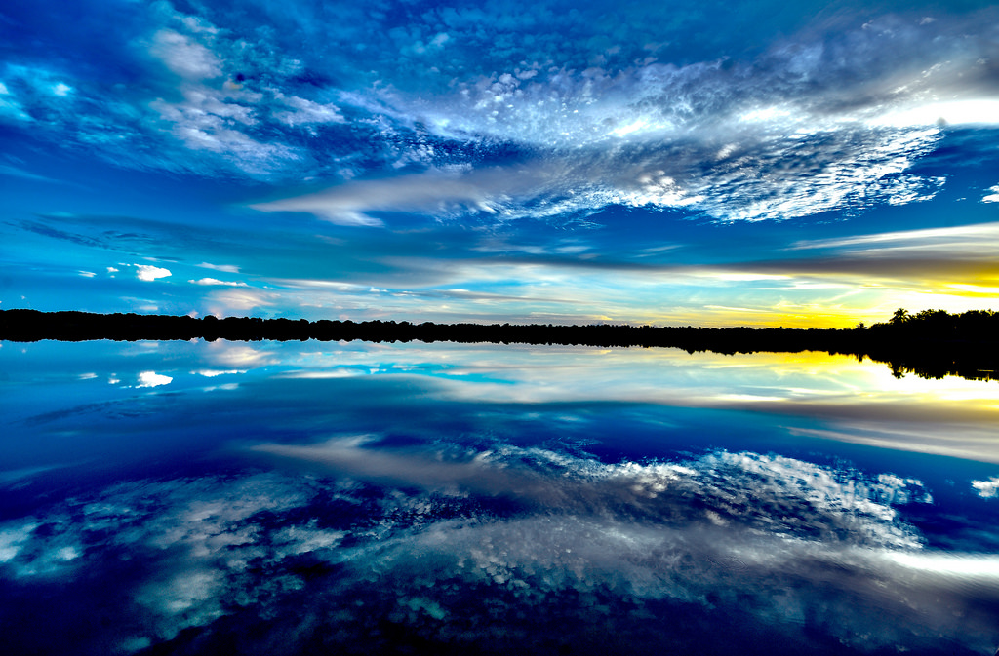
Clean, fresh water
600 million people
don’t have it
Notes:
This is a very conservative estimate (https://watermission.org/global-water-crisis/) reports a full one-third of the Earth’s population lacks access to safe water.
Half of the hospital beds in developing countries are occupied by people with water-borne diseases.

Slide 2
Natural resources: Water
Indispensable for all life
Demands are starting to exceed supplies
Water poverty in the Third World:
‘Large sectors of the population have no access to safe drinking water or experience droughts which impede agricultural production. Some countries have areas rich in water while others endure drastic scarcity’ (Laudato Si’, #27)
Notes:
Even with the water cycle (clouds > rain > evaporation > …), many areas are depleting “fossil aquifers” which are NOT replenished by rain.
Water is needed by agriculture, industry, and nature. Whether we waste water ourselves (e.g., by over-enthusiastic watering of our lawns in the summer) or indirectly (by eating animals that have consumed a staggering amount of water when alive) - we in the First World, as individuals, have a large water footprint, in some cases larger than can be sustained.
Of course in the Third World the situation in many areas is dire ….
Laudato Si #27: Other indicators of the present situation have to do with the depletion of natural resources. We all know that it is not possible to sustain the present level of consumption in developed countries and wealthier sectors of society, where the habit of wasting and discarding has reached unprecedented levels. The exploitation of the planet has already exceeded acceptable limits and we still have not solved the problem of poverty.
Fresh drinking water is an issue of primary importance, since it is indispensable for human life and for supporting terrestrial and aquatic ecosystems. Sources of fresh water are necessary for health care, agriculture and industry. Water supplies used to be relatively constant, but now in many places demand exceeds the sustainable supply, with dramatic consequences in the short and long term. Large cities dependent on significant supplies of water have experienced periods of shortage, and at critical moments these have not always been administered with sufficient oversight and impartiality. Water poverty especially affects Africa where large sectors of the population have no access to safe drinking water or experience droughts which impede agricultural production. Some countries have areas rich in water while others endure drastic scarcity.
One particularly serious problem is the quality of water available to the poor. Every day, unsafe water results in many deaths and the spread of water-related diseases, including those caused by microorganisms and chemical substances. Dysentery and cholera, linked to inadequate hygiene and water supplies, are a significant cause of suffering and of infant mortality. Underground water sources in many places are threatened by the pollution produced in certain mining, farming and industrial activities, especially in countries lacking adequate regulation or controls. It is not only a question of industrial waste. Detergents and chemical products, commonly used in many places of the world, continue to pour into our rivers, lakes and seas.
Some facts and figures:
There are 58 million lawns in the US, more than one for every two households. The average family of four uses 250 gallons of water per day – about ONE-THIRD used to maintain a lush garden and green lawn (I ought to mention that if you grow native plants and hardy perennials they rarely if ever need supplementary watering….). This is 5 billion gallons of water a day on yards – up to half wasted by watering sidewalks and filling gutters because the grass has reached saturation level – buckinghampa.org; 1900 – 5 gals/person/day; now 62 gals/person/day
Is this really a good use of God’s precious resources?

Slide 3
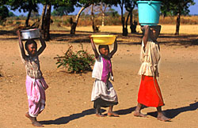
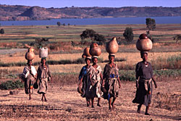
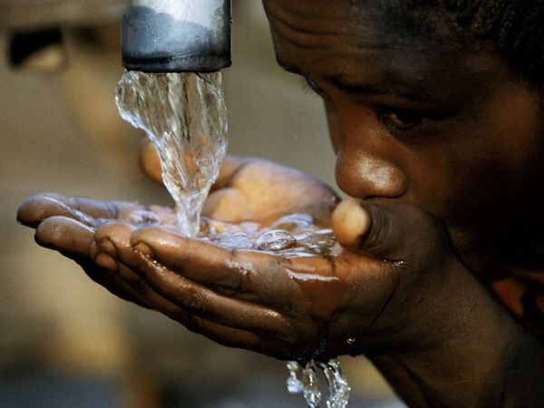
Over half a billion of our brothers and sisters in the Third World are without ready access to clean water
Women in developing countries walk an average of 3.7 miles to get water
80% of illness in the Third World is linked to inadequate water and sanitation
Notes:
It really defies belief that so many people don’t have any access to clean water,
And that they have such a long walk to get water in any state of cleanliness.
Women in developing countries walk an average of 3.7 miles to get water. Dirty water kills 3.3 million people annually.
Water is a gift of God that makes life possible and yet millions of people do not have access to safe drinking water, and rivers, seas and oceans continue to be polluted, Pope Francis said.
"Care for water sources and water basins is an urgent imperative," the pope said in a message Sept. 1, 2018, the World Day of Prayer for the Care of Creation, an observance begun by the Orthodox Church and now celebrated by many Christians.
With the world day 2018 focused on water, Francis drew special attention to the more than 600 million people who do not have regular access to clean drinking water.
"Access to safe drinkable water is a basic and universal human right, since it is essential to human survival and, as such, is a condition for the exercise of other human rights," he said, quoting from his encyclical "Laudato Si'" on the environment.
"In considering the fundamental role of water in creation and in human development," he wrote, "I feel the need to give thanks to God for 'Sister Water,'" as St. Francis of Assisi said. Water is "simple and useful for life like nothing else on our planet."
Fulfilling the Gospel mandate to give the thirsty something to drink involves more than individual acts of charity, although those are important, he said. It also involves "concrete choices and a constant commitment to ensure to all the primary good of water."
Believers have an obligation to thank God for the gift of water and "to praise him for covering the earth with the oceans," Francis said. But they also have an obligation to work together to keep the oceans clean instead of allowing them to be "littered by endless fields of floating plastic."
Children throughout the world suffer greatly because they don't have access to safe water and sanitation. Their health, education and family relationships are affected.
In many countries children, particularly girls, are responsible for the collection of water. Girls as young as 10 years old may take the main responsibility for drawing and carrying the family's water.
The size of the water container may vary with the size of the child, but each liter of water carried weighs 1kg and may need to be carried up to three or four miles.
Pictures – Water Aid

Slide 4
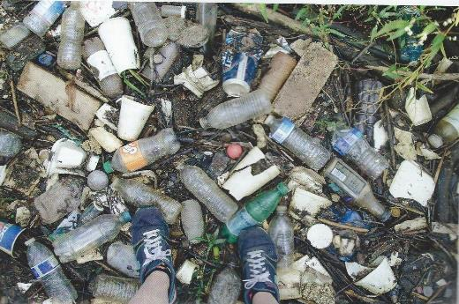
Appreciating God’s gift of water: Pope Francis
Believers have an obligation to thank God for the gift of water and "to praise him for covering the earth with the oceans …“
They also have an obligation to work together to keep the oceans clean instead of allowing them to be "littered by endless fields of floating plastic.“
Notes:
So we privileged “First Worlders” must appreciate this gift of clean water, but also make sure that God’s creation of rivers and seas is not choked with immortal plastic waste,

Slide 5
Plastic waste is everywhere …
Notes:
And that segues into the problems with plastic.
Certainly one humankind’s greatest inventions. Clean, flexible, long-lasting …. And that, unfortunately, is part of the problem.
Long lasting!
Many plastic bags and other plastic detritus end up choking sea turtles, sea birds and other animals. Even when they ‘photodegrade’, they usually just break into tinier and tinier pieces of plastic – which then get eaten by aquatic organisms and carried up the food chain, to seabirds, dolphins, whales … and us.
… with unknown consequences.
Between 5 and 13 million tonnes of plastic enter the ocean each year – estimated to be 150m tonnes there already. 80% from the land.
About 80% of household waste could be recycled. If this was undertaken it would save natural resources and reduce the problem of the disposal of waste. However, recycling is not the whole answer. We all need to learn to use natural resources more sparingly and sensibly – and we can all make a significant contribution in a number of simple ways
International Coastal Cleanup in 2019 – food wrappers (4,771,602) and cigarette butts (4,211,962), made of cellulose acetate.
https://oceanconservancy.org/wp-content/uploads/2020/10/FINAL_2020ICC_Report.pdf

Slide 6
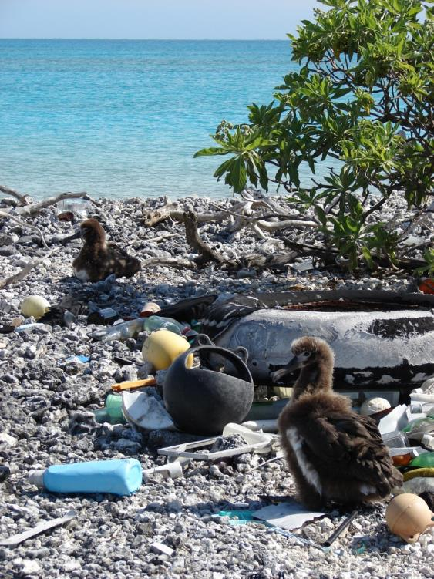
… even Midway Island
Notes:
This plastic mess reaches to the deepest ocean range and the farthest flung tropical island.
Like Midway, in the middle of nowhere where albatross chicks end up being fed plastic instead of fish … and die.
Midway Island is 2.4 sq miles halfway between Asia and North America (hence the name) ; it’s part of the NW Hawaiian archipelago, one-third of the distance between Honolulu and Tokyo. 20 tons of plastic garbage washes up each year; a quarter of it is fed to albatross chicks. These birds only develop the regurgitation reflex at 4 months old, so they cannot spew the plastic out. Sea turtles and monk seals also consume plastic waste.
First Lady Laura Bush, speaking at J.L. Scott Marine Education Center’s Gulf Coast Research Laboratory, at the University of Southern Mississippi in 2007
https://georgewbush-whitehouse.archives.gov/news/releases/2007/11/20071102-11.html
“I've seen what humans can do and what our behavior can do to devastate marine life. ....Midway Island is the only inhabited island of the Northwestern Hawaiian Islands that President Bush designated as a National Marine Monument.
It's 140,000 square miles of National Marine Monument that he named. And when we were there -- we happened to be there at the very same times the Laysan Albatross were nesting. The Laysan Albatross is a tall bird. They nest on the ground because there are no natural predators of theirs at Midway where they nest. And so when we were there, we literally had to look where we walked or we would step on one of these funny little chicks, little Laysan Albatross chicks that were in their nest on the ground.
And they don't leave their nest because their parents do leave and fish on the oceans and then come back and feed them, and so they have to be where their parents left them, and they just instinctively stay in these nests.
We became very fond of these funny little birds that we watched, but we also saw the carcasses of a lot of these infant Laysan Albatross, because when their parents fish, they fish on the surface for squid, and that's where the plastic floats. And so they eat plastic and then feed their babies, regurgitate this plastic that they've eaten.
So we would see the little carcasses, and when we sort of looked in them, you would see cigarette lighters and toothbrushes and bottle caps and toys -- toy cars or little tires from toys -- and every single type of plastic that we all know we use every day.
And this is not from falling off of a boat. I mean, this isn't plastic that fell overboard, although certainly a lot of debris in the ocean is fishing gear that did fall from boats or was tossed from boats. But this could be a cigarette lighter somebody dropped in a curb, you know, on their street somewhere in the United States or anywhere in the world, and it slowly washed through the drains out into the oceans, and then finally ended up at these Northwestern Hawaiian Islands.”

Slide 7
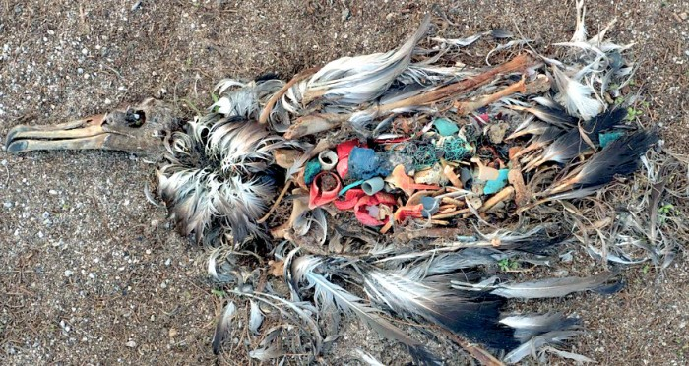
A victim of plastic
Notes:
Midway Atoll in the middle of the Pacific Ocean, showing the effects of man-made garbage on albatross’ living 1,200 miles away from civilization.
There are at least 268,000 tonnes of plastic floating around in the oceans, according to new research by a global team of scientists.
New research has found the risks posed by roughly 5 trillion pieces of plastic floating around in the oceans goes far beyond killing seabirds
The world generates 288m tonnes of plastic worldwide each year, just a little more than the annual vegetable crop, yet using current methods only 0.1% of it is found at sea. The new research illustrates as much as anything, how little we know about the fate of plastic waste in the ocean once we have thrown it “away”.
Where does it go? Most obviously, this discarded plastic exists as the unsightly debris we see washed ashore on our beaches.
These large chunks of plastic are bad news for sea creatures which aren’t used to them. Turtles, for instance, consume plastic bags, mistaking them for jellyfish. In Hawaii’s outer islands the Laysan albatross feeds material skimmed from the sea surface to its chicks. Although adults can regurgitate ingested plastic, their chicks cannot. Young albatrosses are often found dead with stomachs full of bottle tops, lighters and other plastic debris, having starved to death. https://www.chinadialogue.net/article/show/single/en/7593-The-true-horror-of-the-damage-inflicted-by-plastic-waste-in-the-oceans
Laura Bush: So we would see the little carcasses, and when we sort of looked in them, you would see cigarette lighters and toothbrushes and bottle caps and toys -- toy cars or little tires from toys -- and every single type of plastic that we all know we use every day.

Slide 8
A victim of plastic

Slide 9
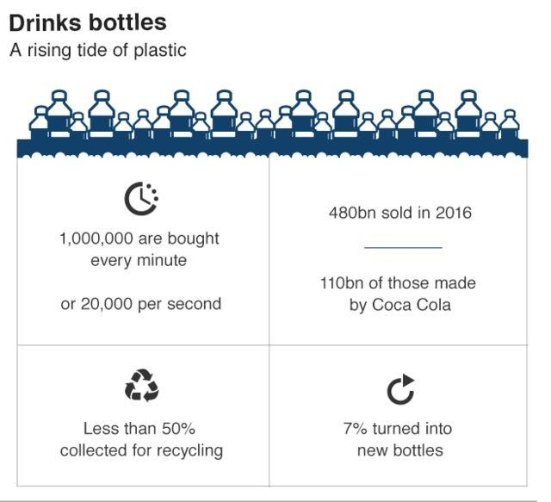
… and a bottle takes 450 years to “rot down”
Notes:
A million bottles per minute globally.
To date we have made ~ 8.3 bn tonnes of virgin plastic - - by 2015, this had created 6.3 bn tonnes of waste plastic; 79% in landfill or oceans, 9% recycled, 12% incinerated.

Slide 10
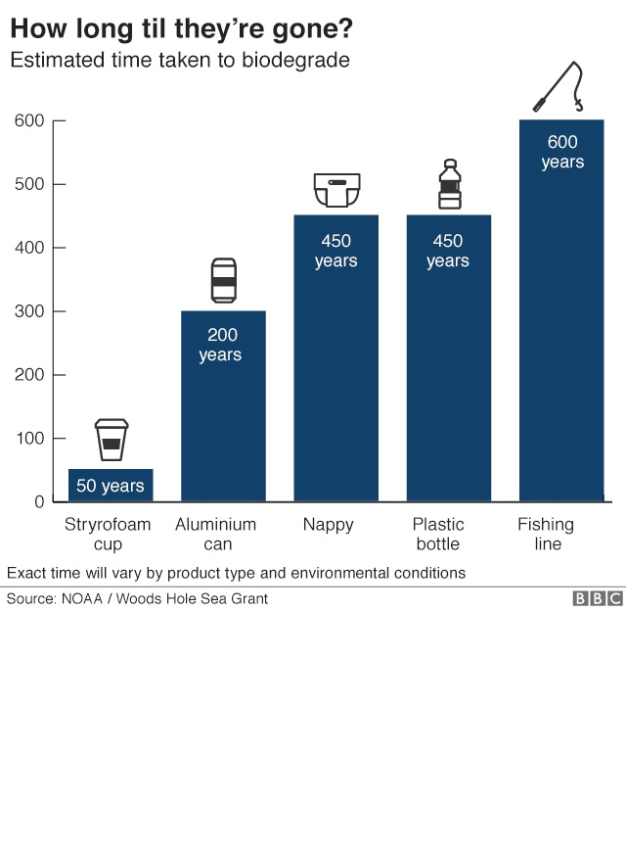

Slide 11
We are pathetic at plastic recycling
Barely 10%
Only plastics numbered 1, 2 and 5 are generally recycled
Be careful with plastic bags
Notes:
Recycling Isn’t as Clear-Cut as You Might Think – WSJ
Plastics that have the potential to be recycled are stamped with a triangle made of three arrows enclosing a resin-identification code—a digit from 1 to 7 that indicates the type of plastic—but the presence of the emblem doesn’t guarantee the waste will be reused, even if it makes it into a recycling bin.
“People think a lot more is being recycled than is actually being recycled,” said Jennie Romer, author of “Can I Recycle This?” “Most of it is low-value and doesn’t have a buyer.”
Collected material is sorted based on resin type and—if there’s a market for that particular type of plastic—processed into pellets that will be made into new products.
“From the curbside, it’s generally the 1s and 2s and some of the 5s,” said Bret Biggers, an economist with the Institute of Scrap Recycling Industries. “Anything else, they have to pay to get rid of it.”
Plastics that have the potential to be recycled are stamped with a triangle made of three arrows enclosing a resin-identification code—a digit from 1 to 7 that indicates the type of plastic—but the presence of the emblem doesn’t guarantee the waste will be reused, even if it makes it into a recycling bin.
“People think a lot more is being recycled than is actually being recycled,” said Jennie Romer, author of “Can I Recycle This?” “Most of it is low-value and doesn’t have a buyer.”
Collected material is sorted based on resin type and—if there’s a market for that particular type of plastic—processed into pellets that will be made into new products.
“From the curbside, it’s generally the 1s and 2s and some of the 5s,” said Bret Biggers, an economist with the Institute of Scrap Recycling Industries. “Anything else, they have to pay to get rid of it.”
In curbside recycling programs, there’s little or no domestic market for No. 3 plastics made of PVC, or polyvinyl chloride; No. 4 plastics, such as plastic film and frozen-food bags, made of low-density polyethylene; No. 6 plastics, including party cups and plastic utensils, made of polystyrene; or No. 7 plastics, a catchall category for all other resins.
Of the resins that do get recycled, almost 100% of clear No. 2 plastics are turned into new packaging, Mr. Bell said, while the colored versions often end up as black agricultural piping. About 25% of the No. 1 plastics become new bottles, with the remainder primarily used for clothing and carpets. And No. 5 plastics are used for items such as paint cans, toothbrushes or deodorant sticks.
In general, Mr. Bell said plastics should be washed and dried before they’re tossed into a recycling bin. Labels don’t need to be removed, and caps can be left on, even if they’re made of a different resin.
Processing facilities won’t open black bags. Clear bags have the potential to get tangled in machinery. USE A SPECIFIC DROPOFF FOR THEM.
An even better strategy, she said, is to use less up front.
“Bring your own everything,” Ms. Romer said. “Bags. Water bottles. Cutlery. The goal is to live without single-use plastic.”

Slide 12
Direct water pollutants
Insecticides, herbicides, mercury, mining debris, oil, hormones, detergents, pharmaceuticals…
These pollutants directly poison wildlife and humans

Slide 13
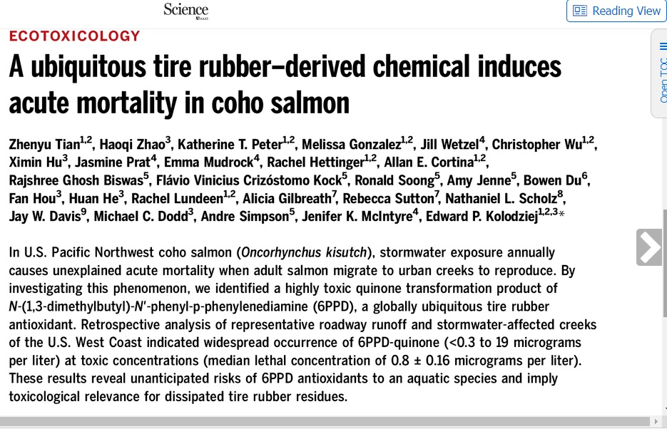
Direct water pollutants
Insecticides, herbicides, mercury, mining debris, oil, hormones, detergents, pharmaceuticals…
These pollutants directly poison wildlife and humans
Notes:
New research published linking car tires to salmon-killing pollution.

Slide 14
‘Stealth’ pollutants
There are also chemicals such as DDT, PCBs, dioxins, polybrominated diphenyl ethers, BPA, phthalates, and perfluorooctanoic acid (PFOA) which have the potential of being “endocrine disruptors”
And these chemicals are globally pervasive
Notes:
Water pollution by more than “just” plastic is a concern. As well as being directly and acutely toxic – poisons like mercury still affect the poverty-stricken people in the Third World - there are signs that low levels of pollutants such as plasticizers are acting as estrogen-like chemicals – the so-called endocrine disruptors or “gender benders” that are causing water-living creatures such as frogs, toads and salamanders to have aberrant sex organs. And these problems will be felt all over the world, not just where there’s an absence of the Clean Water Act.
See Wikipedia article: https://en.wikipedia.org/wiki/Endocrine_disruptor
http://pediatrics.aappublications.org/content/112/Supplement_1/247.full
Evidence of Effects of Environmental Chemicals on the Endocrine System in Children
Walter J. Rogan, N. Beth Ragan
Pediatrics
July 2003, VOLUME 112 / ISSUE Supplement 1
‘Although endocrine disruption in humans by pollutant chemicals remains largely undemonstrated, the underlying science is sound and the potential for such effects is real’ (Pediatrics Journal)
DDT was banned not only because of acute toxicity but also because it broke down in the environment so very slowly. It accumulated in the food chain – insects were eaten by fish that were eaten by bald eagles, brown pelicans and ospreys – whose population crashed. Why? Because the DDT was concentrated, stored in the body tissue, and disrupted the calcium status of the birds (it acted as a type of ‘regulating hormone’ to the birds). Thin eggshells resulted which led to the baby bird never making it out alive.
Mercury, transformed into organic mercury compounds in the environment, is a very nasty slow poison of the nervous system. Furthermore, many places in China are experiencing mercury toxicity through air pollution – they have no Clean Air Act!

Slide 15
Natural resources: Oceans
Oceans: using them sustainably
Preserving the beauty of coral reefs
Notes:
Like rainforests, oceans are of infinite benefit to humankind. As the Holy Father says (Laudato Si, #40), ‘Oceans not only contain the bulk of our planet’s water supply, but also most of the immense variety of living creatures, many of them still unknown to us and threatened for various reasons. What is more, marine life in rivers, lakes, seas and oceans, which feeds a great part of the world’s population, is affected by uncontrolled fishing, leading to a drastic depletion of certain species’.
‘In tropical and subtropical seas, we find coral reefs comparable to the great forests on dry land, for they shelter approximately a million species, including fish, crabs, molluscs, sponges and algae. Many of the world’s coral reefs are already barren or in a state of constant decline. “Who turned the wonderworld of the seas into underwater cemeteries bereft of colour and life?”’ (LS, #41)

Slide 16
Using oceans sustainably
Fish and shellfish form a significant part of the world's diet…for free!
But we are almost fished out
Personal action makes a difference
Be aware of what you’re eating and where it came from
Support sustainable fisheries to help people AND the environment
Notes:
Bad news:
Senegalese fishermen are being driven to suicidal boat trips to Europe as they have lost their livelihoods
Destroying mangroves to build shrimp farms led to a much greater damage in the Indian Ocean tsunami in December 2004.
Shrimp and fish farms use a lot of veterinary drugs and pesticides which cause pollution (as does the effluent from the concentrated populations of fish)
Over the next fifty years, if current trends continue, all currently fished species will be diminished to endangered levels
Good news
Wegmans offers sustainably farmed shrimp from Belize, and specializes in sustainably fished species.
Wal-Mart is enforcing strict rules on Thailand shrimp farms – they must replant three times the mangroves they destroy and clean up their effluent rather than have it discharge into the environment (Best Aquaculture Practices) – bapcertification.org

Slide 17
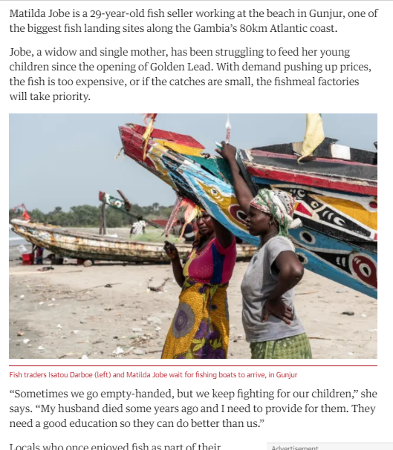
Notes:
‘Catastrophic’: Sierra Leone sells rainforest for Chinese harbour | Sierra Leone | The Guardian (May 2021)
Chinese fishmeal plants leave fishermen in the Gambia all at sea | Global development | The Guardian (March 2019)

Slide 18
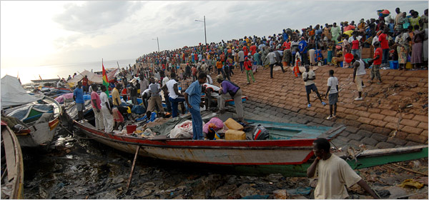
Overfishing’s tragic consequences
How is overfishing connected to migrants drowning trying to get to Europe?
Fishermen in Bissau, Guinea-Bissau; credit: Candace Feit for The New York Times
Notes:
Many West African fishermen are finding it impossible to find enough fish to live on. Factory ships from Europe, America and Asia have - essentially – vacuumed up all the fish that live there.
So more and more fishermen choose to take the very dangerous step of trying to get to Spanish-owned Canary Islands, off the coast of North Africa, as a gateway to Europe.
KAYAR, Senegal — Ale Nodye, the son and grandson of fishermen in this northern Senegalese village, said that for the past six years he netted barely enough fish to buy fuel for his boat. So he jumped at the chance for a new beginning. He volunteered to captain a wooden canoe full of 87 Africans to the Canary Islands in the hopes of making their way illegally to Europe.
The 2006 voyage ended badly. He and his passengers were arrested and deported. His cousin died on a similar mission not long afterward.
Nonetheless, Mr. Nodye, 27, said he intended to try again.
“I could be a fisherman there,” he said. “Life is better there. There are no fish in the sea here anymore.”
https://www.nytimes.com/2008/01/14/world/africa/14fishing.html
Picture: Fishermen in Bissau, Guinea-Bissau. Overfishing has depleted once-bountiful African waters. Credit Candace Feit for The New York Times

Slide 19
Overfishing’s tragic consequences
Men who were picked up at sea as they tried to flee West Africa standing on a patrol boat in Los Cristianos in Tenerife, in the Canary Islands.
Credit: Arturo Rodriguez/Associated Press
Notes:
The decline of fishing has contributed to the flood of migrants to Europe.
Men who were picked up at sea as they tried to flee West Africa standing on a patrol boat in Los Cristianos in Tenerife, in the Canary Islands. .Credit Arturo Rodriguez/Associated Press
https://www.nytimes.com/2008/01/14/world/africa/14fishing.html

Slide 20
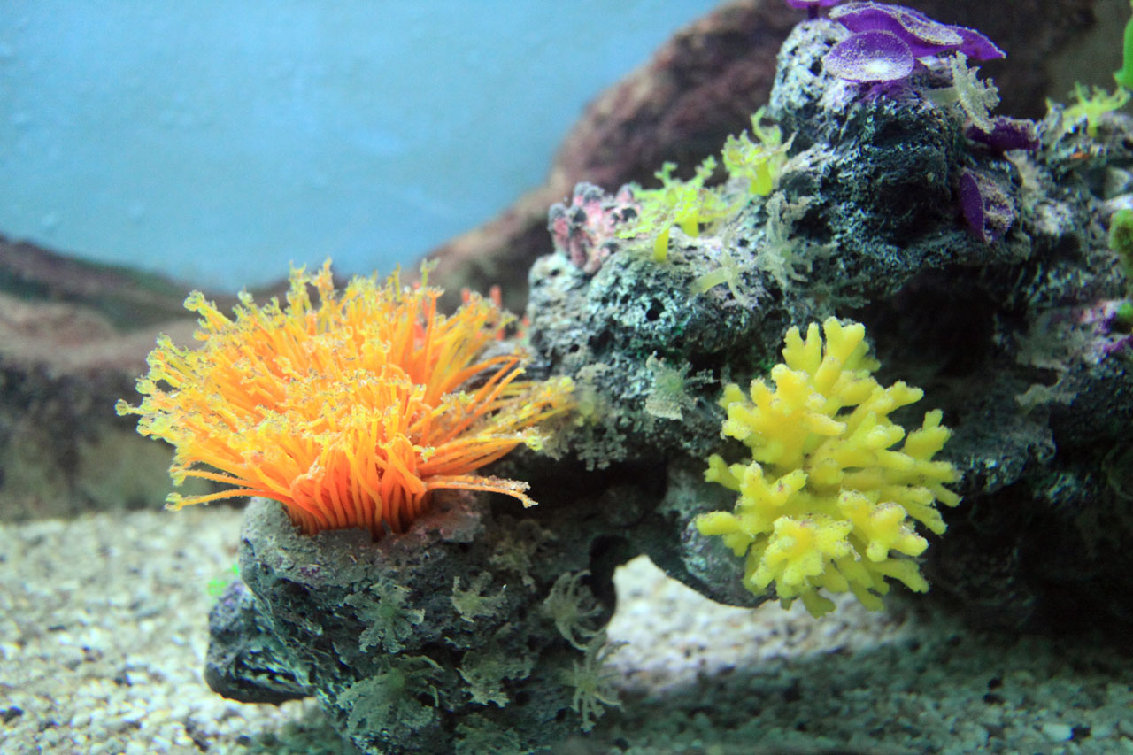
Coral reefs
The 'marine rainforests'
This Photo by Unknown Author is licensed under CC BY
Notes:
NOAA Coral Reef Conservation Program - The Coral Reef Conservation Program Celebrates 20 Years
Coral reef ecosystems sustain and protect lives, livelihoods, and coastal property. They support recreational fishing and diving, commercial fishing, and pharmaceutical research, and provide protection from waves and flooding. Each year, coral reefs pump more than $3.4 billion into the U.S. economy.
Coral reefs are threatened by stressors that include land-based sources of pollution, unsustainable fishing practices, and a changing climate. As a result, more than 25 percent of the world’s coral reefs have been lost in the last three decades. There are 22 coral species listed as threatened and three species listed as endangered under the Endangered Species Act.
Yet it’s not too late to save coral reefs. Scientists and conservationists are studying reefs, as well as the most effective ways to reduce the impacts of pollution, unsustainable fishing, climate change, and other threats. Active restoration often helps give coral reefs time to recover from stressors. Through these efforts, corals can continue to prosper for present and future generations.
Now looking specifically at coral reefs, which are – as it says here – as intricate an ecosystem as the rainforest, just as important, and just as endangered.

Slide 21
Coral reefs …
… are beautiful and indispensable
Essential fish nurseries and source of pharmaceuticals
Notes:
Not only are reefs the spawning grounds and nurseries for lots of species of fish (that we eat) - - the new antibiotics and anti-cancer drugs found in coral reef organisms are just as unexpected as any found on dry land or in the lab.

Slide 22
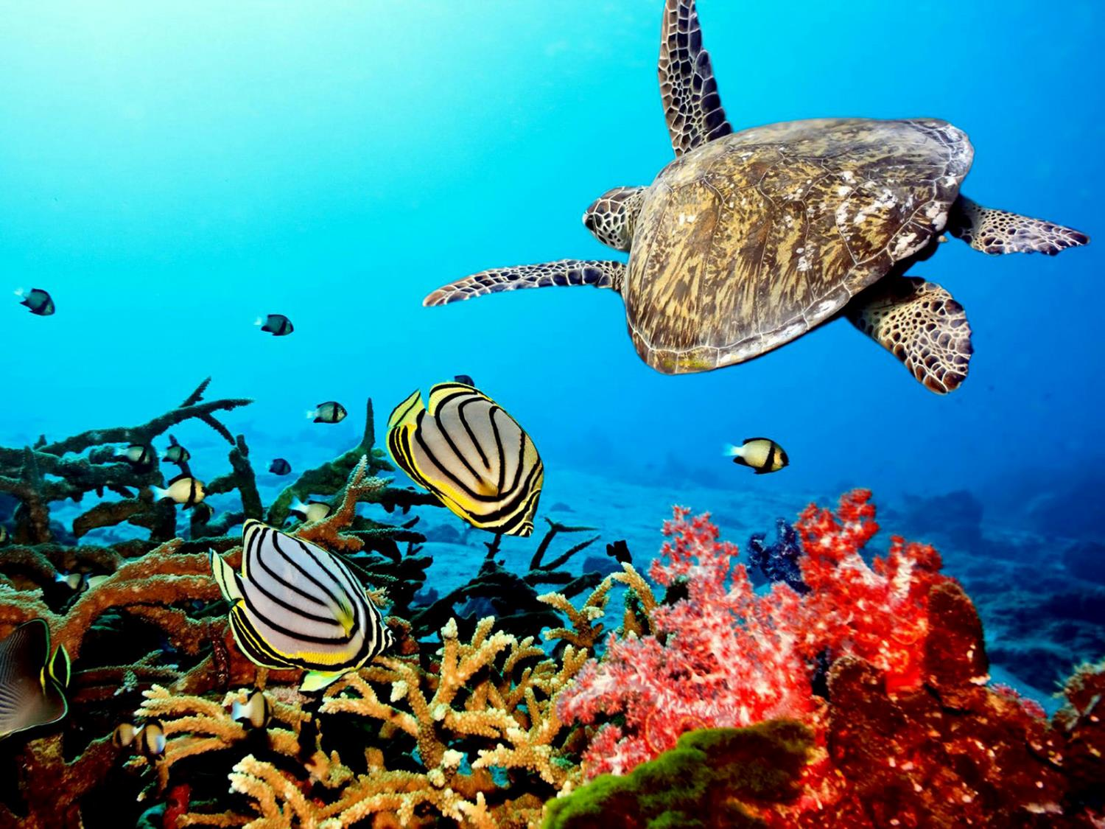
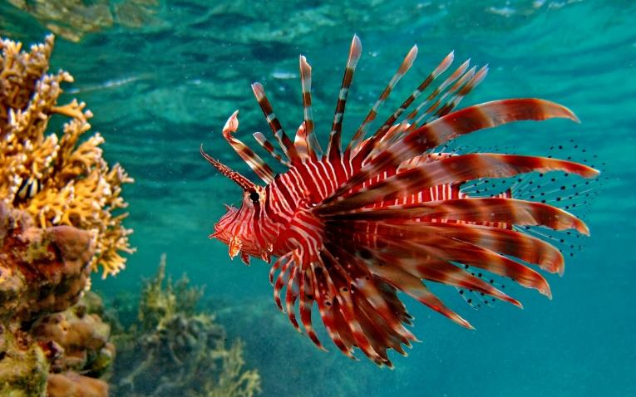
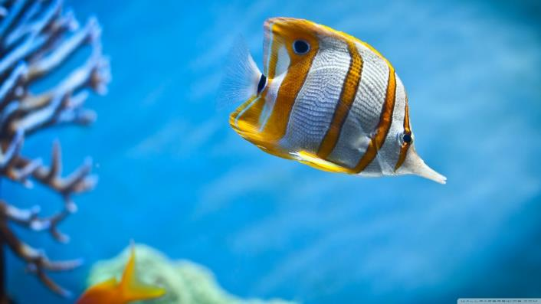
Notes:
And reefs are wonderful places.

Slide 24
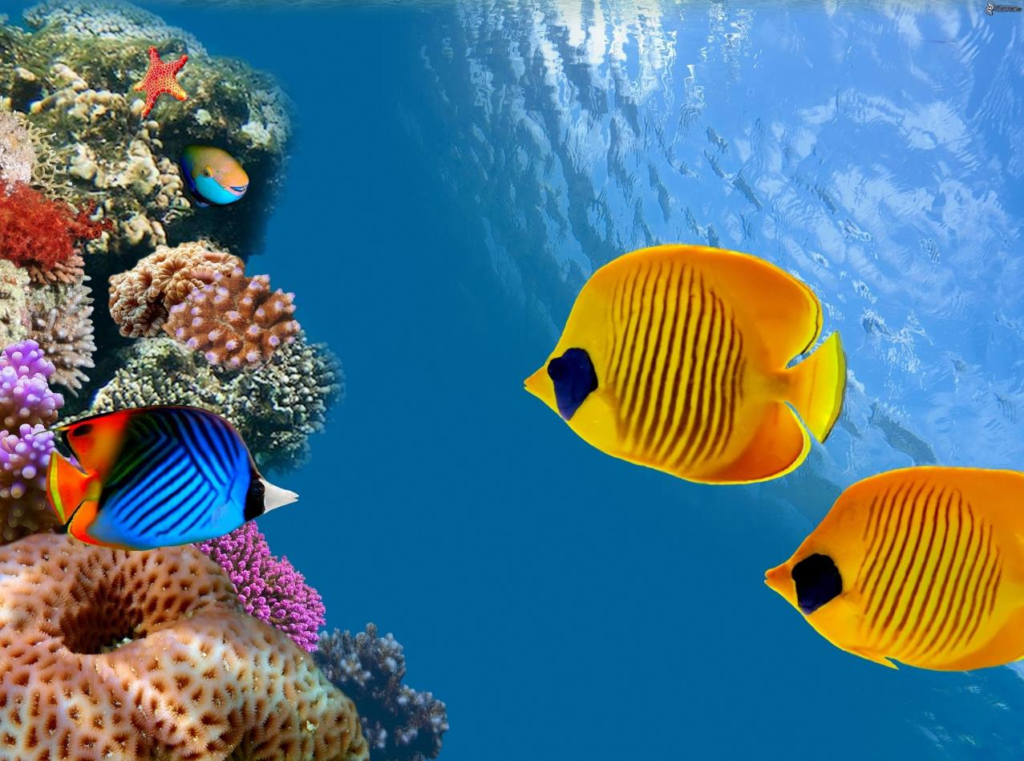

Slide 25
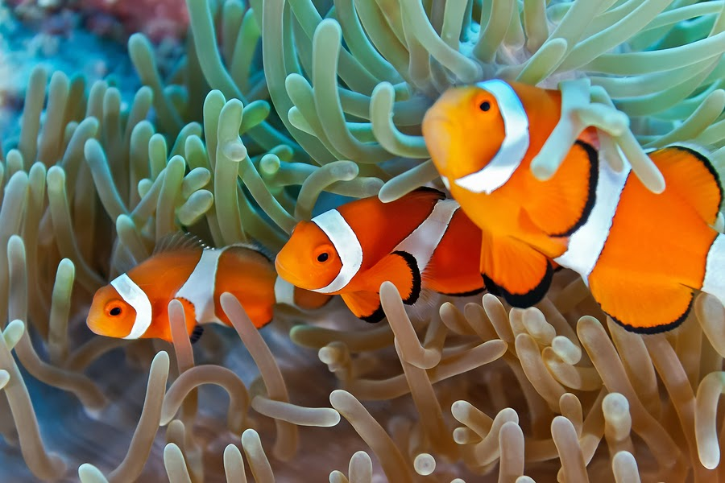

Slide 26
Coral reefs are in trouble
Runoff of polluted water
Overfishing
Cyanide
Acidification from increased CO₂ in the atmosphere
Bleaching due to high temperatures
Notes:
Since the beginning of the Industrial Revolution, the acidity of surface ocean waters has increased by about 30%.^{13,14} This increase is the result of humans emitting more carbon dioxide into the atmosphere and hence more being absorbed into the ocean. The ocean has absorbed between 20% and 30% of total anthropogenic carbon dioxide emissions in recent decades (7.2 to 10.8 billion metric tons per year).^{15,1}
https://climate.nasa.gov/evidence/
13. http://www.pmel.noaa.gov/co2/story/What+is+Ocean+Acidification%3F
14. http://www.pmel.noaa.gov/co2/story/Ocean+Acidification
15. C. L. Sabine et.al., “The Oceanic Sink for Anthropogenic CO₂,” Science vol. 305 (16 July 2004), 367-371

Slide 27
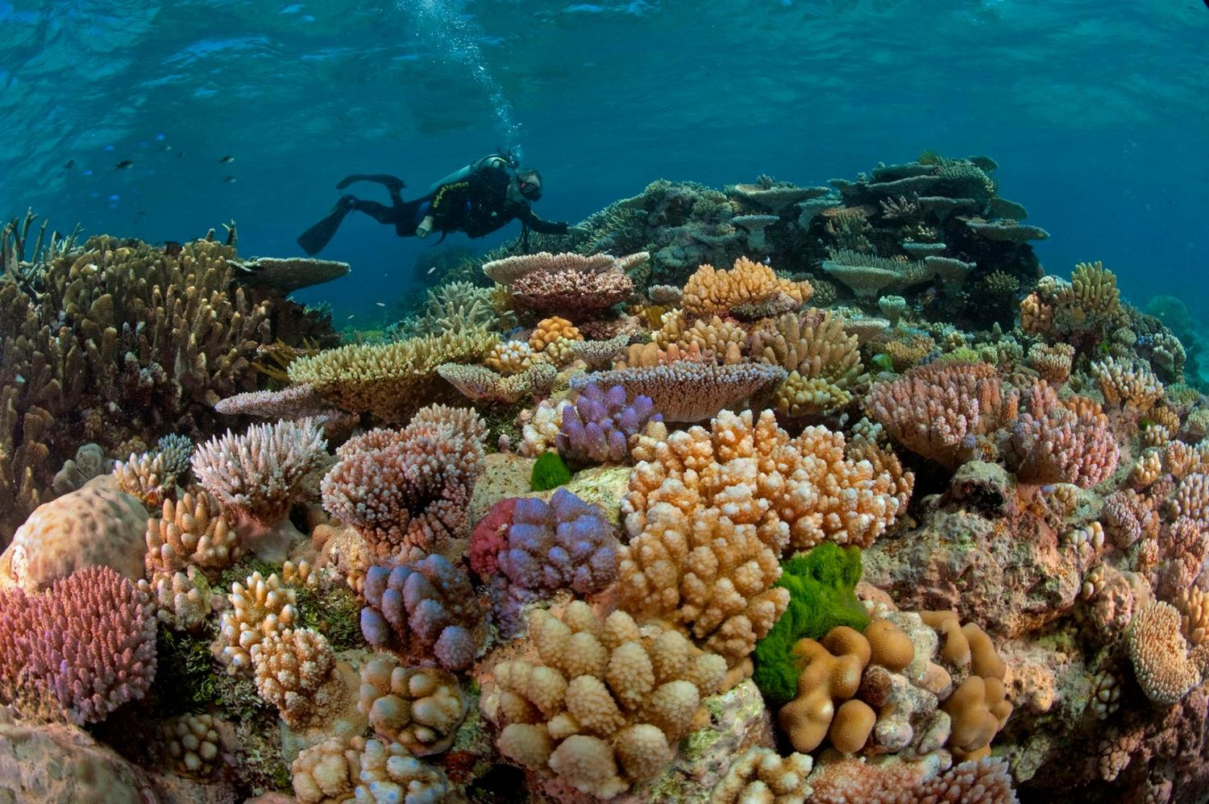

Slide 28
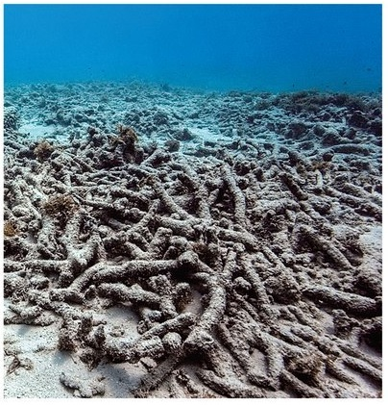
“Who turned the wonderworld of the seas into underwater cemeteries bereft of color and life?”
Notes:
Laudato Si #40. Oceans not only contain the bulk of our planet’s water supply, but also most of the immense variety of living creatures, many of them still unknown to us and threatened for various reasons. What is more, marine life in rivers, lakes, seas and oceans, which feeds a great part of the world’s population, is affected by uncontrolled fishing, leading to a drastic depletion of certain species. Selective forms of fishing which discard much of what they collect continue unabated. Particularly threatened are marine organisms which we tend to overlook, like some forms of plankton; they represent a significant element in the ocean food chain, and species used for our food ultimately depend on them.
#41. In tropical and subtropical seas, we find coral reefs comparable to the great forests on dry land, for they shelter approximately a million species, including fish, crabs, molluscs, sponges and algae. Many of the world’s coral reefs are already barren or in a state of constant decline. “Who turned the wonderworld of the seas into underwater cemeteries bereft of colour and life?” [Catholic Bishops’ Conference of the Philippines, Pastoral Letter What is Happening to our Beautiful Land? (29 January 1988).
This phenomenon is due largely to pollution which reaches the sea as the result of deforestation, agricultural monocultures, industrial waste and destructive fishing methods, especially those using cyanide and dynamite. It is aggravated by the rise in temperature of the oceans. All of this helps us to see that every intervention in nature can have consequences which are not immediately evident, and that certain ways of exploiting resources prove costly in terms of degradation which ultimately reaches the ocean bed itself.
#42. Greater investment needs to be made in research aimed at understanding more fully the functioning of ecosystems and adequately analyzing the different variables associated with any significant modification of the environment. Because all creatures are connected, each must be cherished with love and respect, for all of us as living creatures are dependent on one another. Each area is responsible for the care of this fam25 Catholic Bishops’ Conference of the Philippines, Pastoral Letter What is Happening to our Beautiful Land? (29 January 1988). 31 ily. This will require undertaking a careful inventory of the species which it hosts, with a view to developing programmes and strategies of protection with particular care for safeguarding species heading towards extinction..

Slide 29
How can I make any difference?
“Faced as we are
with global environmental deterioration,
I wish to address
every person living on this planet...”
(Pope Francis, Laudato Si’ #3)

Slide 30
Protecting these critical resources
Clean unpolluted water
Plastics
Coral reefs

Slide 31
Clean water

Slide 32
Water
There are 58 million lawns in the US, more than one for every two households.
The average family of four uses 250 gallons of water per day – about ONE-THIRD used to maintain a lush garden and green lawn
Five billion gallons of water a day goes onto yards
Much of it wasted by watering sidewalks and filling gutters because the grass has reached saturation level
Is this really a good use of God’s precious resources?
Notes:
buckinghampa.org; 1900 – 5 gals/person/day; now 62 gals/person/day
And we can also try to conserve water in the house too….
Showers 2.5 galls/minute
Bathtubs 20-50 gallons
Toilets 1.6 gallons/flush
Washing machines 40 gallons per load [more modern ones 18-25 gallons per load]
Dishwashers 15 gallons per load [more modern ones 30% less]
Alas we cannot send the water we’ve saved to those in the Third World with no clean water – but at least we are showing solidarity with them.

Slide 33
Water
Half the water used in a home is used in the bathroom:
Have a shower rather than a bath
Use a plug in sinks rather than washing under a running tap
In the kitchen and laundry:
Keep a pitcher of drinking water in the refrigerator instead of letting the faucet run until the water is cool
Add food wastes to your compost pile instead of the garbage disposal
When using a washing machine or dishwasher, always run a full load
Notes:
And we can also try to conserve water in the house too….
Showers 2.5 galls/minute
Bathtubs 20-50 gallons
Toilets 1.6 gallons/flush
Washing machines 40 gallons per load [more modern ones 18-25 gallons per load]
Dishwashers 15 gallons per load [more modern ones 30% less]

Slide 34
Water in the backyard
In the hot summer months, or in dry climates, a household's outdoor water use can be as high as 70 per cent. So …
Install a rain barrel, linking it to a down pipe to collect water from a roof
Water plants in the evening after the heat of the day
Plant perennials and native plants rather than ‘thirsty’ annuals
Mulch water-loving plants
If you have to use sprinklers, use them wisely
Notes:
And we can also try to conserve water in the house too….
Showers 2.5 galls/minute
Bathtubs 20-50 gallons
Toilets 1.6 gallons/flush
Washing machines 40 gallons per load [more modern ones 18-25 gallons per load]
Dishwashers 15 gallons per load [more modern ones 30% less]

Slide 35
Reducing our ‘plastic footprint’

Slide 36
Reducing our plastic footprint
Recycling is very important, but will only help reduce pollution for a few designated types
Reducing the amount of plastic you BUY is critical, especially single-use knives, forks and spoons, plastic wraps, and so on
In your grocery shopping:
Search out glass bottles rather than plastic
Use reusable bags or paper

Slide 37
Helping coral reefs

Slide 38
How to help reefs
Only buy sustainably caught/farmed seafood
Moderate your carbon footprint:
Increasing water temperatures are killing coral reefs
Increasing carbon dioxide levels make seawater more acidic, preventing reefs from making new coral
Notes:
Choose sustainably fished/farmed sea food. If you eat fish that was caught sustainably, you know you are conserving God’s creation and helping feed someone’s family. If you eat fish that has harvested unsustainably, you are not only driving that species towards extinction – you are quite likely to be depriving someone poorer than yourself of a livelihood. Look for Marine Stewardship Council certification, and when shopping or if you're out for a meal, check the eco-friendliness of the fish by checking out Seafood Watch
Reduce your carbon footprint: corals are killed by high sea temperatures and are also endangered with carbon dioxide dissolving in the ocean and making the water more acidic. Visit https://www.ecophilly.org/personal-action

Slide 39
This is not optional (LS #217)
‘ “The external deserts in the world are growing, because the internal deserts have become so vast”. For this reason, the ecological crisis is also a summons to profound interior conversion. It must be said that some committed and prayerful Christians, with the excuse of realism and pragmatism, tend to ridicule expressions of concern for the environment…..’
Notes:
AS BENEDICT XVI SAID:
“The external deserts in the world are growing, because the internal deserts have become so vast”.
“The external deserts in the world are growing, because the internal deserts have become so vast”. For this reason, the ecological crisis is also a summons to profound interior conversion. It must be said that some committed and prayerful Christians, with the excuse of realism and pragmatism, tend to ridicule expressions of concern for the environment. Others are passive; they choose not to change their habits and thus become inconsistent. So what they all need is an “ecological conversion”, whereby the effects of their encounter with Jesus Christ become evident in their relationship with the world around them. Living our vocation to be protectors of God’s handiwork is essential to a life of virtue; it is not an optional or a secondary aspect of our Christian experience.”
(LS #217)

Slide 40
This is not optional (LS #217)
‘…Others are passive; they choose not to change their habits and thus become inconsistent. So what they all need is an “ecological conversion”, whereby the effects of their encounter with Jesus Christ become evident in their relationship with the world around them.
[BUT] …Living our vocation to be protectors of God’s handiwork is essential to a life of virtue; it is not an optional or a secondary aspect of our Christian experience.”
Notes:
AS BENEDICT XVI SAID:
“The external deserts in the world are growing, because the internal deserts have become so vast”
“The external deserts in the world are growing, because the internal deserts have become so vast”. For this reason, the ecological crisis is also a summons to profound interior conversion. It must be said that some committed and prayerful Christians, with the excuse of realism and pragmatism, tend to ridicule expressions of concern for the environment. Others are passive; they choose not to change their habits and thus become inconsistent. So what they all need is an “ecological conversion”, whereby the effects of their encounter with Jesus Christ become evident in their relationship with the world around them. Living our vocation to be protectors of God’s handiwork is essential to a life of virtue; it is not an optional or a secondary aspect of our Christian experience.”
(LS #217)

Slide 41
EcoPhilly.org

