Slide 1
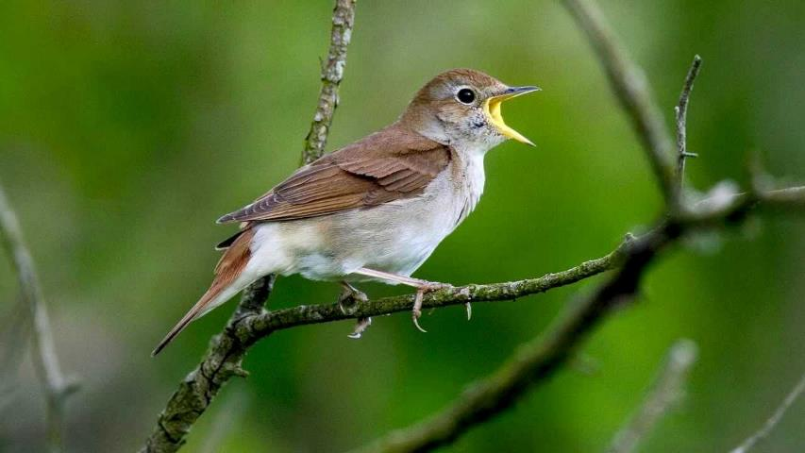
A Catholic Christian Response to the Biodiversity Crisis
Notes:
I would like to present the basis of a Christian response, a call to action, to save the web of life, Earth’s biodiversity, from what seems to be inevitable degradation and destruction. I think we’d all prefer this …

Slide 2
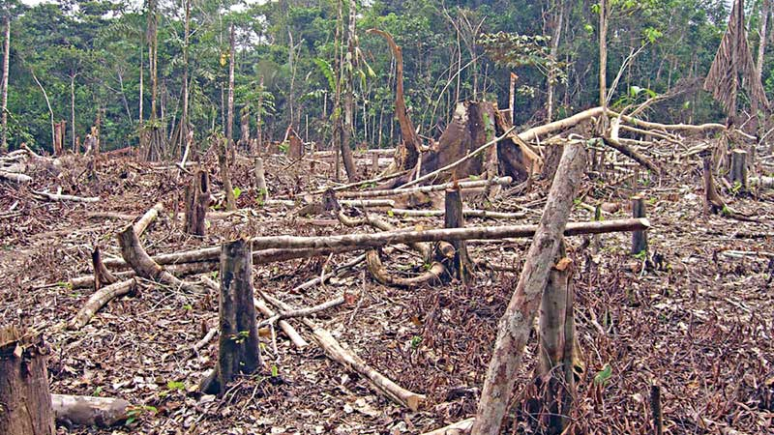
A Catholic Christian Response to the Biodiversity Crisis
Notes:
… to this.
THIS is what happens when thoughtless and greedy men can access virgin rain forest – they cut down the trees for wood, burn the stumps to boost (temporarily) soil nutriment, and plant oil palms, soybeans or grass (to feed cattle).

Slide 3
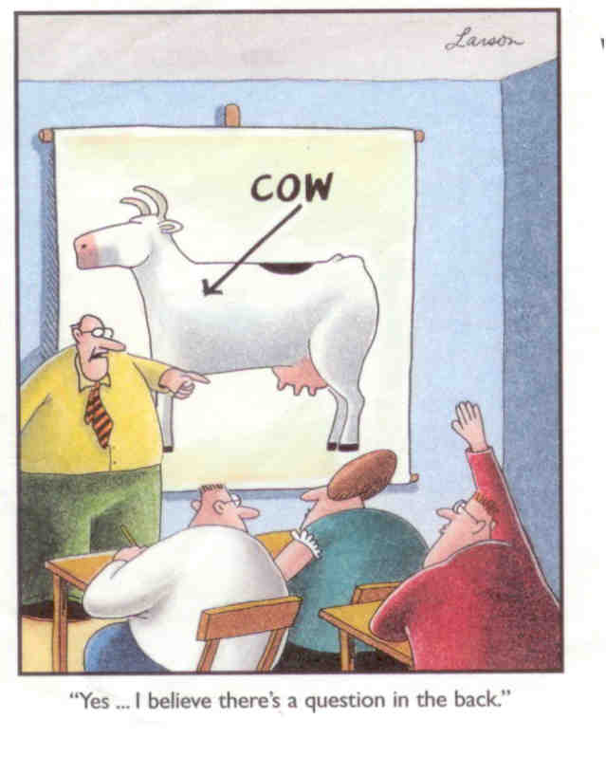
Notes:
Hold difficult questions till end, unless (as in this case) you’re sure they’ll be fairly simple.

Slide 4
What do we mean by ‘biodiversity’?
Take a walk in a rainforest or snorkel over a coral reef
The diversity of natural life is eye-popping
We’re now learning that most organisms live very close to each other, allowing the exchange of nutrition and other signals
Notes:
Biodiversity: an ‘ecosystem’ is the web of interactions between microorganisms, fungi, plants and animals. Most systems will have hundreds or thousands of living creatures – a huge amount of biological diversity, or biodiversity for short.
And although we tend to think of rainforests and coral reefs as the height of diversity – and they are! – our backyards and local parks are very beautiful and themselves, important.
And take nothing – no creature – for granted.

Slide 5
What do we mean by ‘biodiversity’?
But we can appreciate biodiversity in our local park or our back yard too
And in appreciating the presence of robins, blue jays, cardinals, house sparrows and pigeons, we grow to love and respect God’s world
Notes:
Biodiversity: an ‘ecosystem’ is the web of interactions between microorganisms, fungi, plants and animals. Most systems will have hundreds or thousands of living creatures – a huge amount of biological diversity, or biodiversity for short.
And although we tend to think of rainforests and coral reefs as the height of diversity – and they are! – our backyards and local parks are very beautiful and themselves, important.
And take nothing – no creature – for granted.

Slide 6
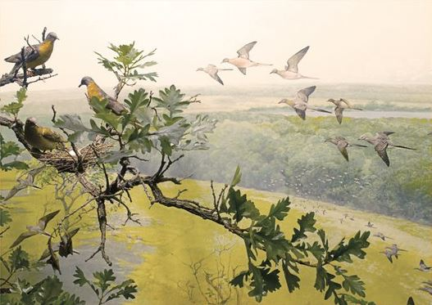
The fragility of a species
Just because something is common now, it doesn’t mean it will be around forever
Passenger Pigeon
Notes:
Notably, the passenger pigeon, whose population at 100 years after the American Revolution was many hundred of billions (individual flocks sometimes of many billions), and with hunting at an industrial scale, it fell to zero (total extinction) by September 1st, 1914, when the last of the line died in Cincinnati Zoo.
https://www.allaboutbirds.org/news/view-from-sapsucker-woods-lessons-from-the-passenger-pigeon/
(John W. Fitzpatrick, “Living Bird”, Autumn 2014)
The painting shown – the Passenger Pigeon diorama at the University of Minnesota’s Bell Museum of Natural History - depicts a scene we will never again witness. Courtesy of the Bell Museum, background painted by Francis Lee Jaques.

Slide 7
When will we stop doing this?
Notes:
And here she is.
Martha, the Last Passenger Pigeon | Smithsonian National Museum of Natural History (si.edu)
https://naturalhistory.si.edu/research/vertebrate-zoology/birds/collections-overview/martha-last-passenger-pigeon
There were once, literally, billions of these birds.
And then there was one.
She was called Martha, and she was alone for the last four years of her life after two males died.

Slide 8
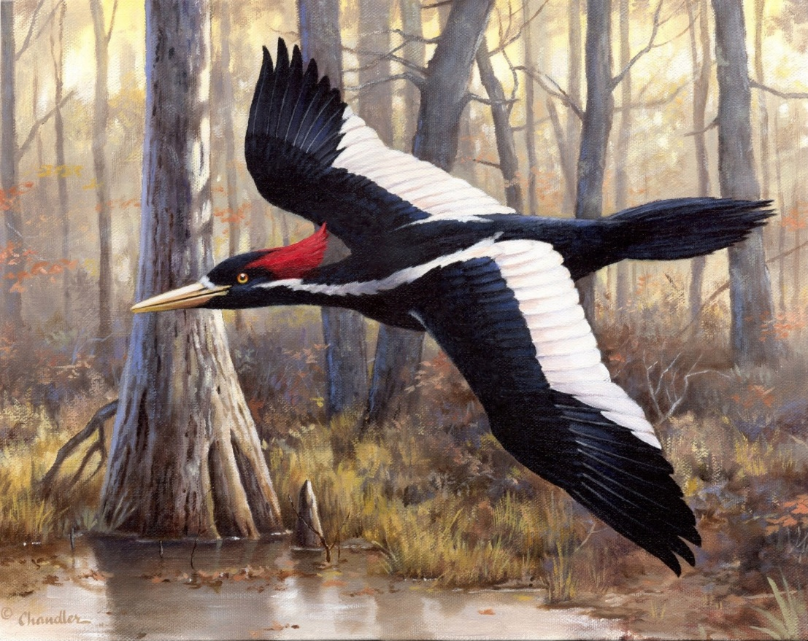
The fragility of a species
Just because something is big and beautiful, it doesn’t mean it will be around forever
Ivory-Billed Woodpecker
Notes:
("Elusive Ivory" by wildlife artist Larry Chandler of Hartselle, Alabama.)
This gorgeous bird is the Ivory-Billed Woodpecker. It was the largest of the woodpeckers north of Mexico and the third largest in the world.
It lived in old-growth forests in the southeastern U.S. and Cuba. Destruction of its forest habitat caused severe population declines in the 1800s, and only very small numbers survived into the twentieth century. It is thought to have gone extinct in the middle of the twentieth century.
It is well-documented that the owners of the last old forest tract, home of the last ivory-billed woodpeckers, knew that the bird was there but actively chose to cash in and clear-cut … wiping out the bird as a regrettable collateral casualty.

Slide 9
When will we stop doing this?
Notes:
John Fitzpatrick wrote in 2014, when considering the accidental or callous erasing of these remarkable creatures
“How could society allow this to happen? The question will haunt and anger me all my life, as it should us all. But a far more important question merits our attention today: When will we stop doing this?
Where nature’s bounty seems limitless we still fail to control ourselves, as in the world’s fisheries. Pacific bluefin tuna have lost 96 percent of their population, yet we hunt them with abandon across the seas to fill cravings for sushi. From cod and grouper to sea bass and sharks, unconscionable overharvesting—aided by ever-advancing technology—continues to collapse fish populations while outcries for reduced harvests draw age-old scorn from fishermen and governments alike. Would it help if we started referring to marine fish as “Passenger Pigeons of the Sea?”
(John W. Fitzpatrick, “Living Bird”, Autumn 2014)

Slide 10
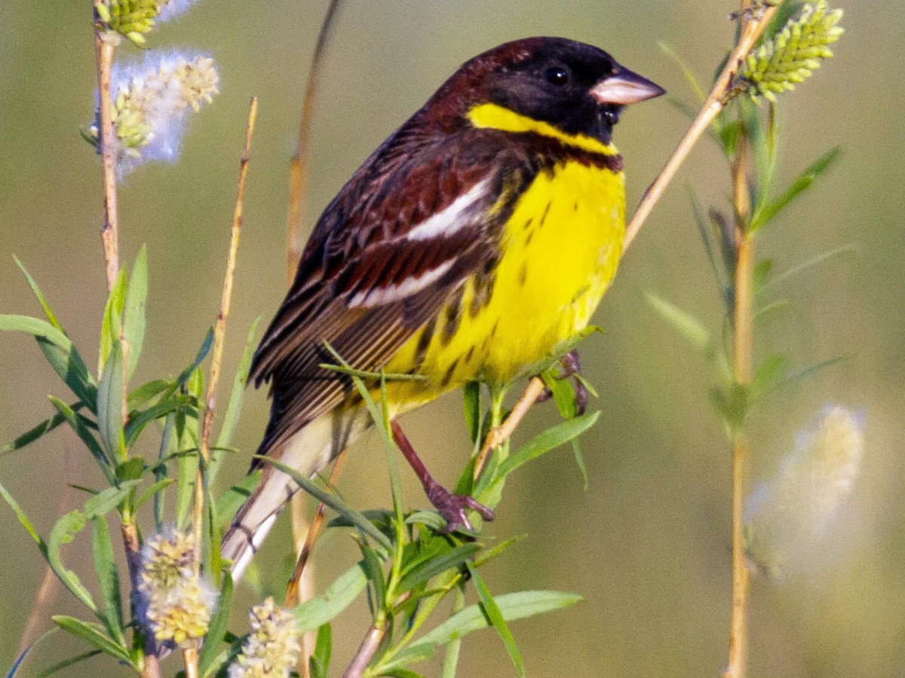
The fragility of a species
Just because something is common now, doesn’t mean it will be around forever
Yellow-Breasted Bunting
Notes:
BUT WE ARE STILL DOING IT
This is a Yellow-Breasted Bunting. It breeds in Russia and winters in China and SE Asia. It’s found in agricultural fields, meadows, and wetlands; it formerly gathered in immense congregations in winter, but it is now critically endangered due to trapping for food. It is seen as a delicacy.

Slide 11
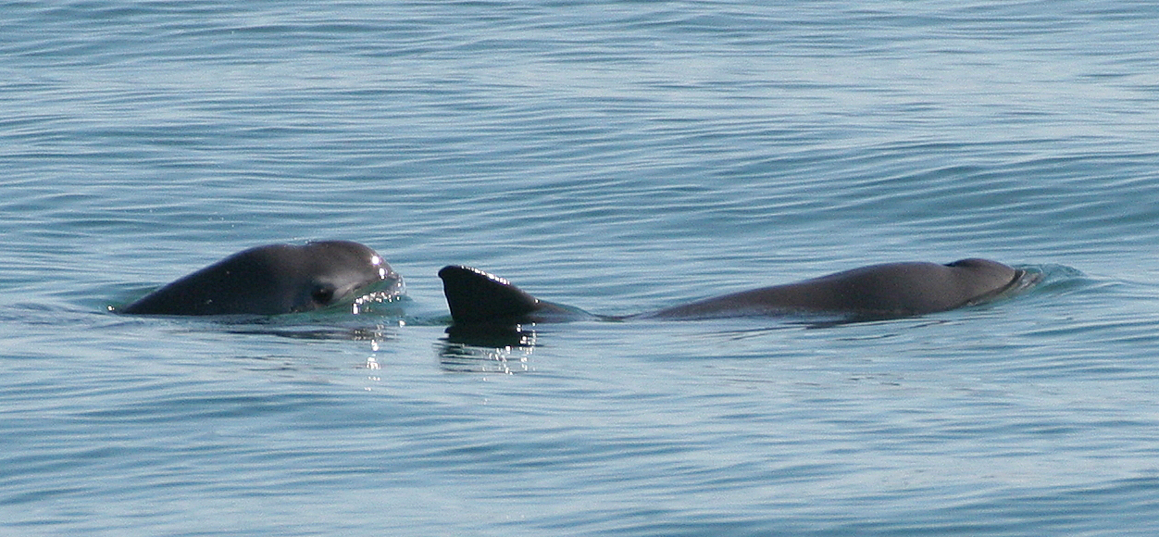
The fragility of a species
Just because everyone knows the animal is endangered, that doesn’t mean it will be saved
Notes:
Vaquita - .**goes into next slide seamlessly**
Photo: By Paula Olson, NOAA - http://www.fisheries.noaa.gov/pr/species/mammals/porpoises/vaquita.html, Public Domain, https://commons.wikimedia.org/w/index.php?curid=30588297
The vaquita is a unique, tiny porpoise species in the Gulf of California, Mexico. Accidentally caught (and drowned) by illegal gill-nets, it is on the edge of extinction.
TWENTY left.

Slide 12
The fragility of a species
Just 20 alive on Earth

Slide 13
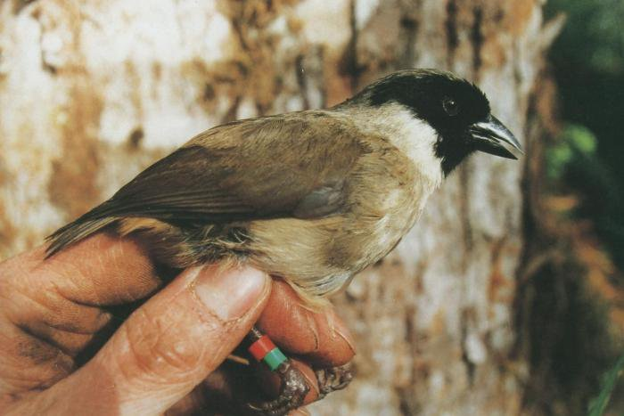
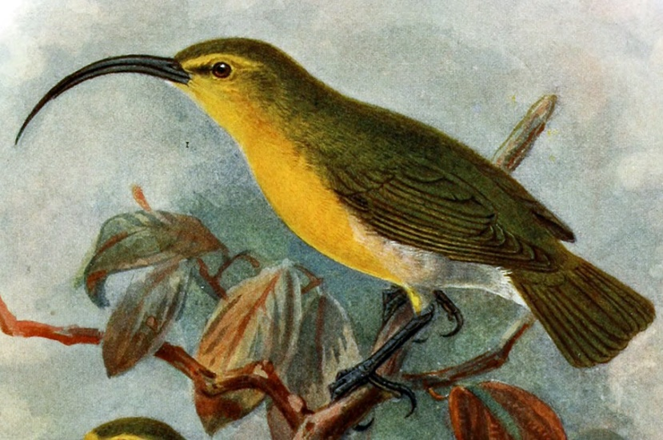
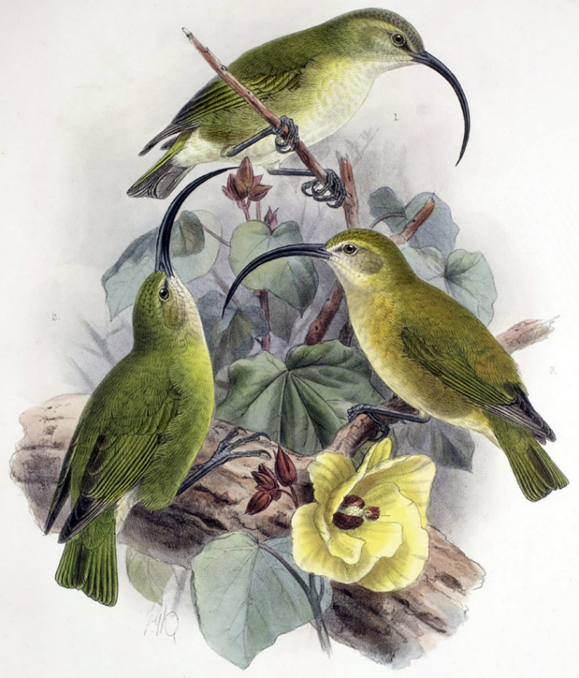
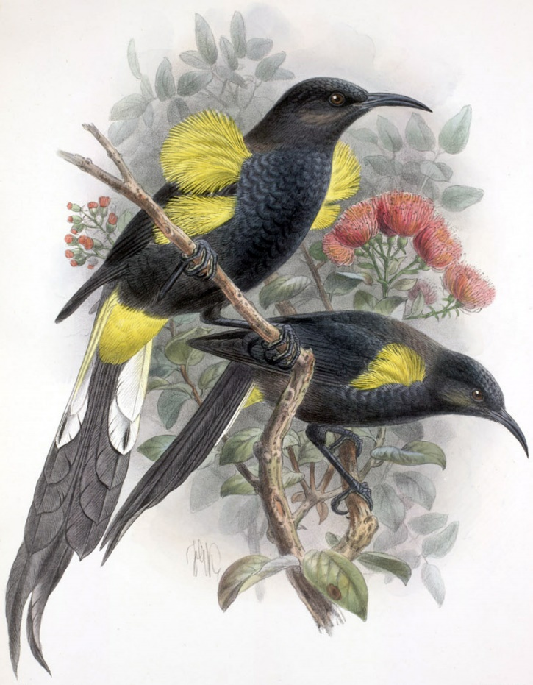
EXTINCT
Notes:
All the animals shown were declared extinct in the 20th and 21st centuries. Dozens of species have no photos or even drawings to mourn them.
What’s on the slide are just a few that died out – all related to one ancestral honeycreeper that flew into Hawaii.
Black-Faced Honeycreeper (Po’ouli). Photo by Hawai'i DLNR Division of Forestry and Wildlife). Several Hawaiian honeycreepers went extinct in the last 50 years.
Akialoa ellisiana
Akialoa lanaiensis. (3 birds)
Hawaiian Oo (black and yellow with yellow tufts)

Slide 14
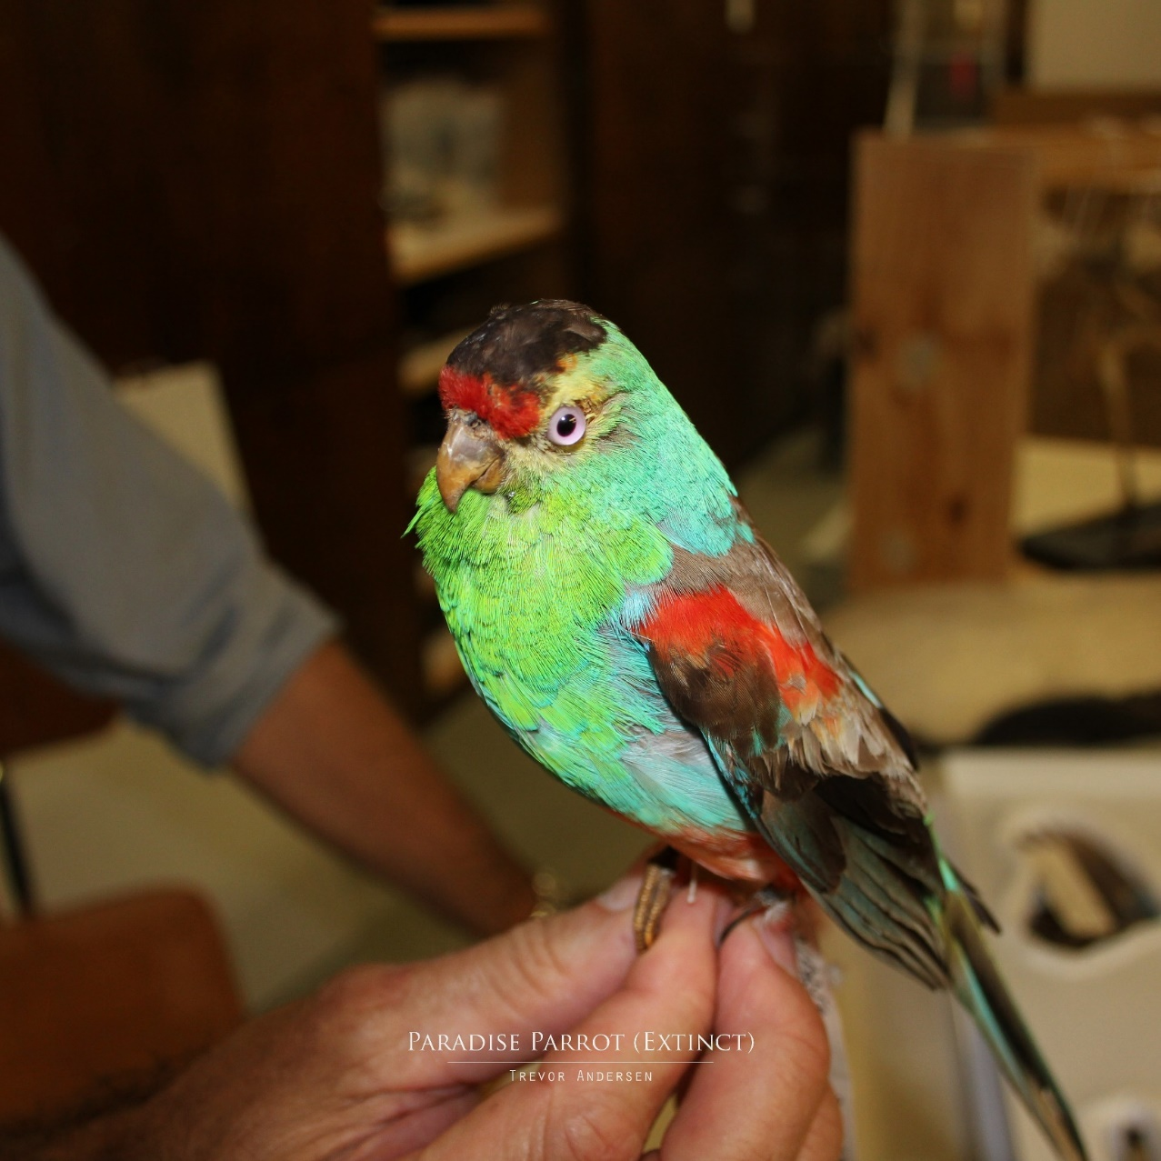
When will we stop doing this?
EXTINCT
Notes:
Paradise Parrot (Australia), extinct by 1920s, probably due to overgrazing, predation by introduced dogs and cats, and land clearance.
(Bowerbirdaus, CC BY-SA 4.0 <https://creativecommons.org/licenses/by-sa/4.0>, via Wikimedia Commons)

Slide 15
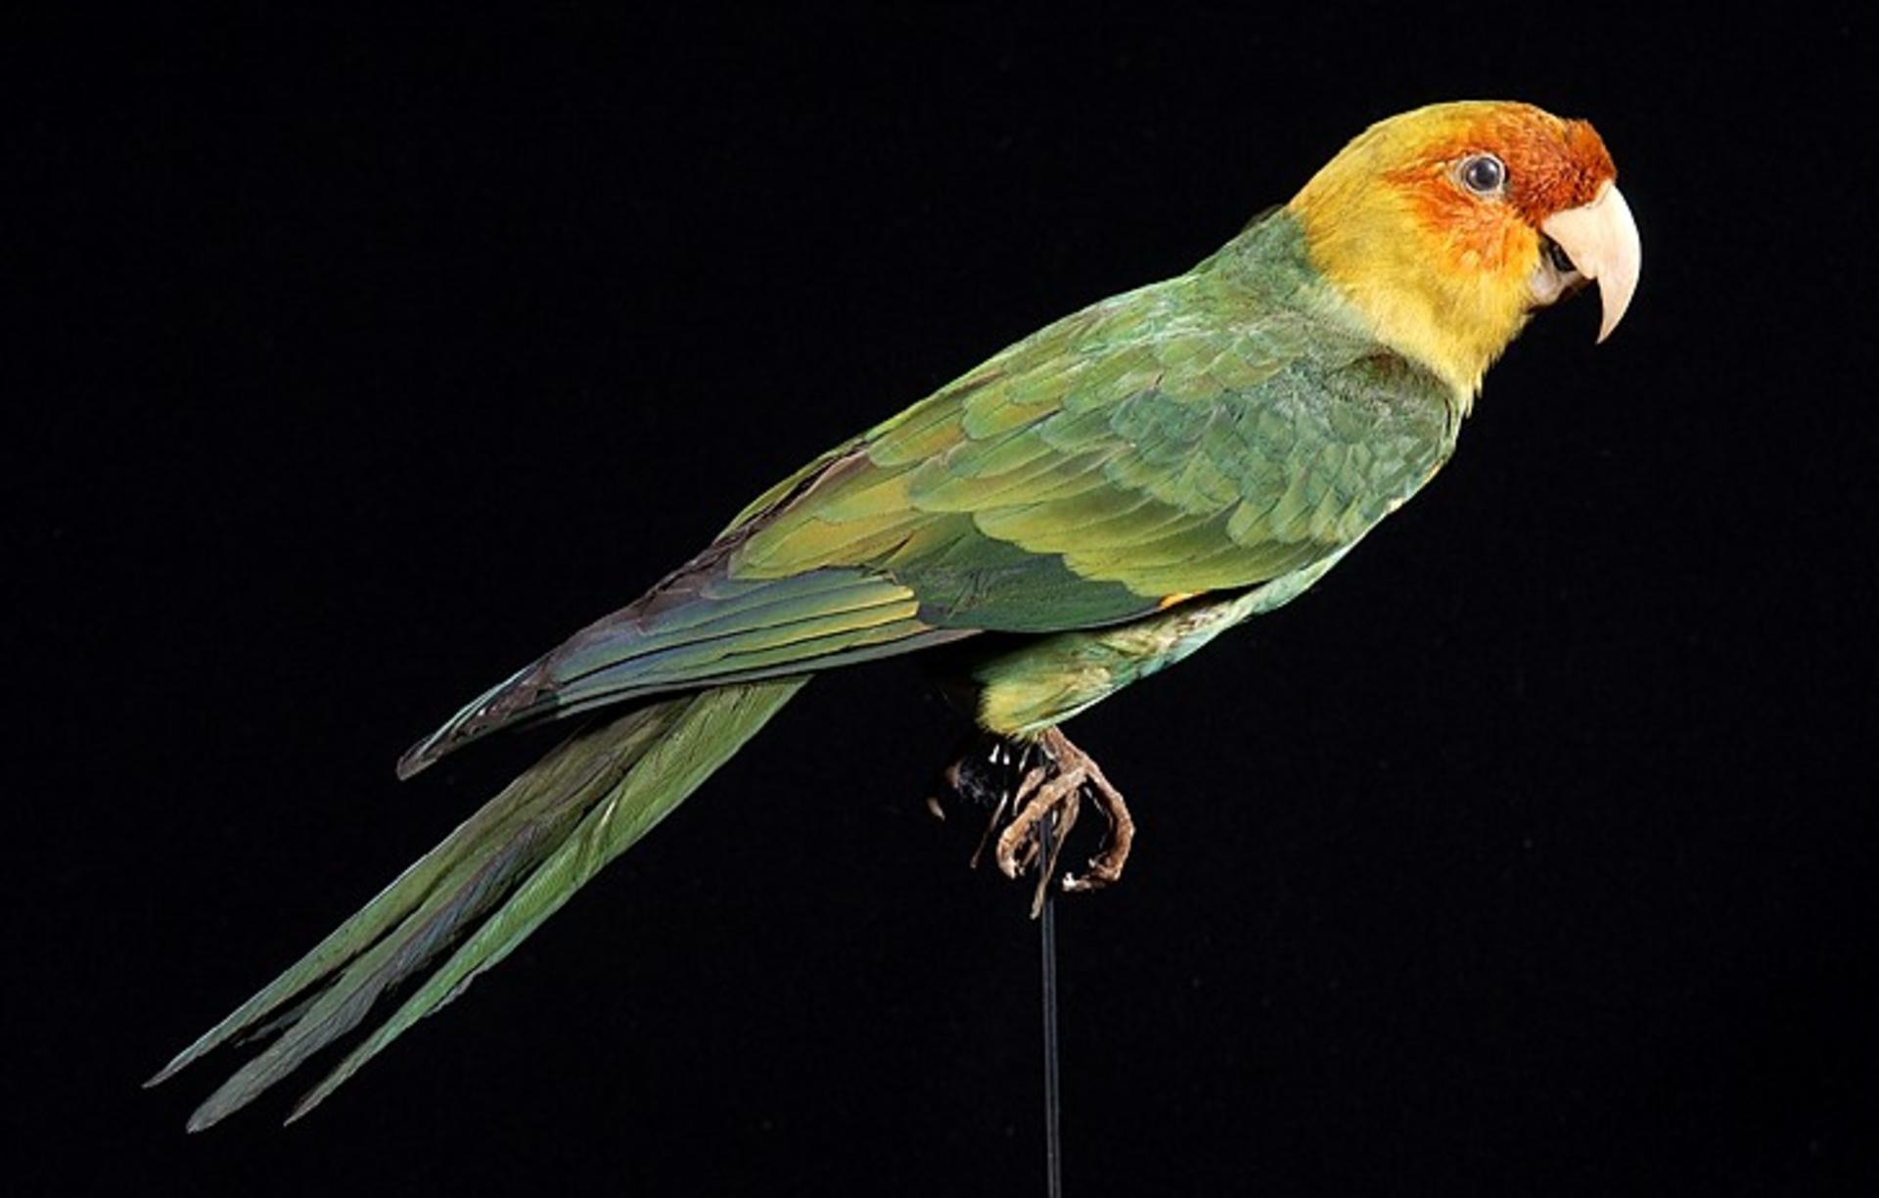
When will we stop doing this?
EXTINCT
Notes:
Another common parrot, Carolina Parakeet (USA). Extinct by the 1910s, probably due to hunting, habitat destruction, and possibly poultry disease.
Huub Veldhuijzen van Zanten/Naturalis Biodiversity Center, CC BY-SA 3.0 <https://creativecommons.org/licenses/by-sa/3.0>, via Wikimedia Commons.

Slide 16
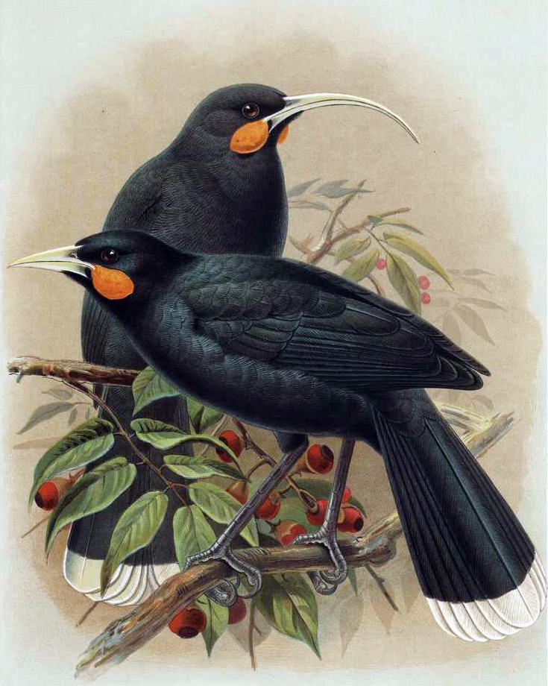
When will we stop doing this?
EXTINCT
Notes:
Huia (New Zealand). An illustration of a pair of Huia, a bird which went extinct in 1907 (approx) due to overhunting and habitat destruction. The bird in the background with the long curved beak is an adult female and the bird in the foreground is an adult male. No other bird species shows such dramatic male/female divergence.

Slide 17
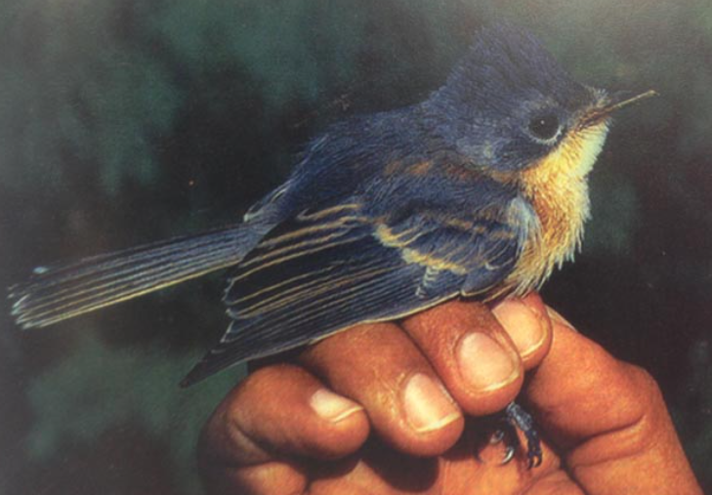
When will we stop doing this?
EXTINCT
Notes:
Yet – here is one that died out as recently as the advent of color photography!
Guam Flycatcher, extinct 1983. Yet another bird species wiped out by the Brown Tree Snake, an invasive species.

Slide 18
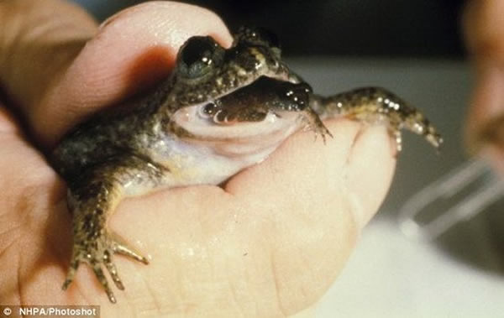
When will we stop doing this?
EXTINCT
Notes:
The gastric-breeding frog: there were two species living n Queensland. Both are thought to be extinct.
There are many frogs that take protection of their young to the extreme.
The female swallowed fertilized eggs and kept the eggs in the stomach until adult frogs had developed.
Apart from their miraculous uniqueness, these frogs (discovered in 1974, extinct in mid-80s) would surely have illuminated research into the control of gastric acidity. Ah well, too late to find out now.

Slide 19
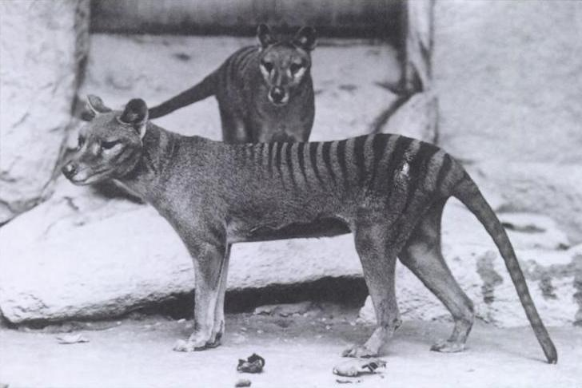
When will we stop doing this?
EXTINCT
Notes:
The Tasmanian Tiger (thylacine). Australian mainland, Tasmania, Papua New Guinea.
A carnivorous marsupial ‘wolf’ the size of a large dog.
Extinct by 1930.
Photo By Baker; E.J. Keller. - Report of the Smithsonian Institution. 1904from the Smithsonian Institution archives. Published example other information: [1]Additional information: Female thylacine (front) with juvenile male offspring (rear). (30 September 2020). &quot;A Catalogue of the Thylacine captured on film&quot;. Australian Zoologist 41 (2): 143–178. DOI:10.7882/AZ.2020.032., Public Domain, https://commons.wikimedia.org/w/index.php?curid=58331

Slide 20
Iconic species on the brink
Notes:
All of the animals on the next slide are in danger of extinction in the wild

Slide 21
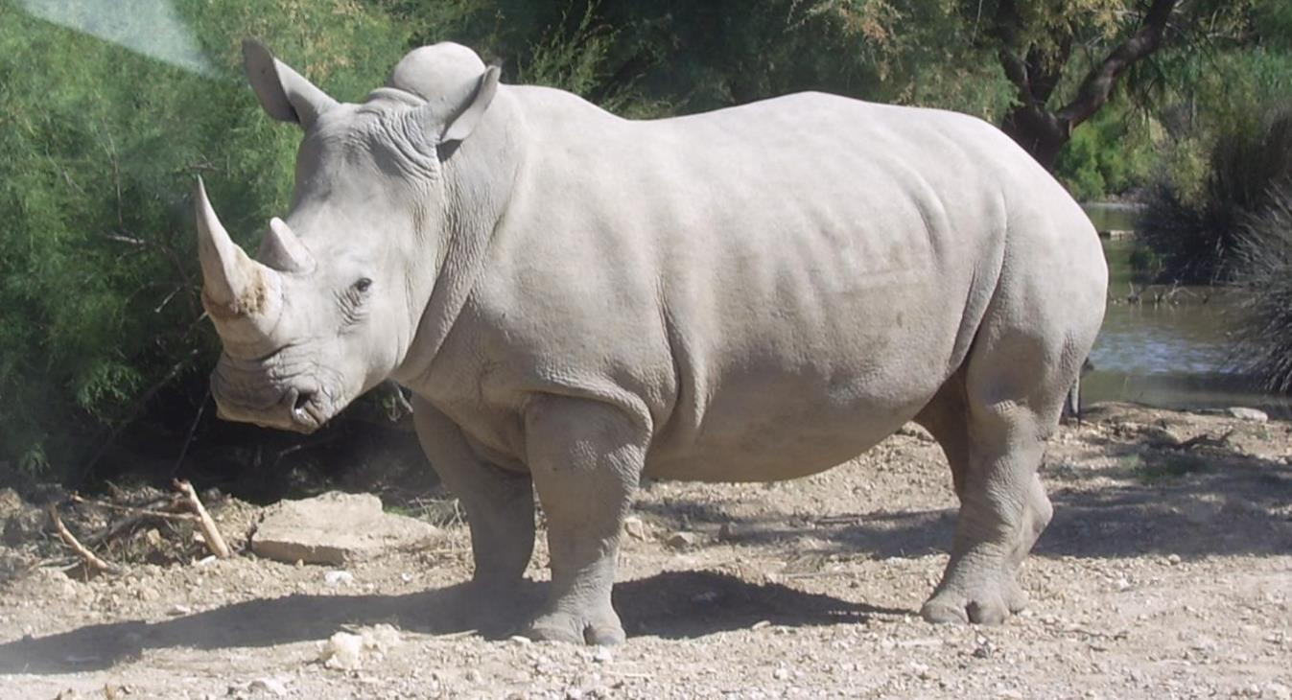
Keystone, iconic animals on the very brink of extinction
Notes:
Since the early 20th century, tiger populations have lost at least 93% of their historic range, extirpated in Western and Central Asia, from the islands of Java and Bali, and in large areas of Southeast and South Asia and China. Today's tiger range is fragmented, stretching from Siberian temperate forests to subtropical and tropical forests on the Indian subcontinent and Sumatra.
The tiger is listed as endangered on the IUCN Red List. As of 2015, the global wild tiger population was estimated to number between 3,062 and 3,948 mature individuals, with most of the populations living in small pockets isolated from each other. India currently hosts the largest tiger population. Major reasons for population decline are habitat destruction, habitat fragmentation and poaching. Tigers are also victims of human–wildlife conflict.
African Bush and African Forest Elephants – hunted for ivory.
Black and white rhinos (Africa); Indian, Javan and Sumatran rhinos. These are hunted for their horn, under the false impression that consuming Chinese medicines with ground up horn will bring good health. That’s a bit like adding toenail clippings to your meal.
Pangolins in Africa and Asia. All eight species are hunted for their meat and scales; all are endangered, two of them critically. More pangolins are trafficked than any other species (thought to be a million over the last decade).
Scales are used in “medicine.”
Vulture populations have crashed in Asia and Africa, mainly through accidental poisoning by their carrion food retaining lethal levels of diclofenac (given to the animal while alive).
The disappearance of vultures has led to the accumulation of dead animals and hence, an increase in the population of feral dogs, which spread rabies. This is a concrete example of disrupting an ecosystem causing grave and tragic consequences.
Finally, the helmeted hornbill (SE Asia) is shot for its kinda-looks-like-ivory-and-can-be-carved-in-a-similar-way bill.

Slide 22
Rainforests
Notes:
ocea

Slide 23
Rainforests
Jewels of biodiversity
Beautiful and indispensable
Threatened by:
Destruction for timber
Oil palm plantations
Cattle grazing
Soybean production
Coffee production
(Laudato Si’, #38, #39)
Notes:
Another environmental catastrophe in the making is the disdain for, and neglect of, the Earth’s rainforests. They have an almost infinite variety of the most interesting and beautiful animals and plants, yet face multiple existential threats.
Laudato Si’ 38. Let us mention, for example, those richly biodiverse lungs of our planet which are the Amazon and the Congo basins, or the great aquifers and glaciers. We know how important these are for the entire earth and for the future of humanity. The ecosystems of tropical forests possess an enormously complex biodiversity which is almost impossible to appreciate fully, yet when these forests are burned down or levelled for purposes of cultivation, within the space of a few years countless species are lost and the areas frequently become arid wastelands. A delicate balance has to be maintained when speaking about these places, for we cannot overlook the huge global economic interests which, under the guise of protecting them, can undermine the sovereignty of individual nations. In fact, there are “proposals to internationalize the Amazon, which only serve the economic interests of transnational corporations”. We cannot fail to praise the commitment of international agencies and civil society organizations which draw public attention to these issues and offer critical cooperation, employing legitimate means of pressure,
39. The replacement of virgin forest with plantations of trees, usually monocultures, is rarely adequately analyzed. Yet this can seriously compromise a biodiversity which the new species being introduced does not accommodate. Similarly, wetlands converted into cultivated land lose the enormous biodiversity which they formerly hosted. In some coastal areas the disappearance of ecosystems sustained by mangrove swamps is a source of serious concern.
In fact, we are going to have a catastrophe of catastrophes if the damage continues at the current rate.

Slide 24
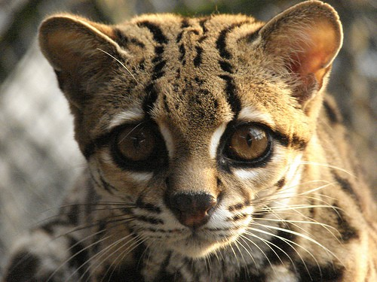
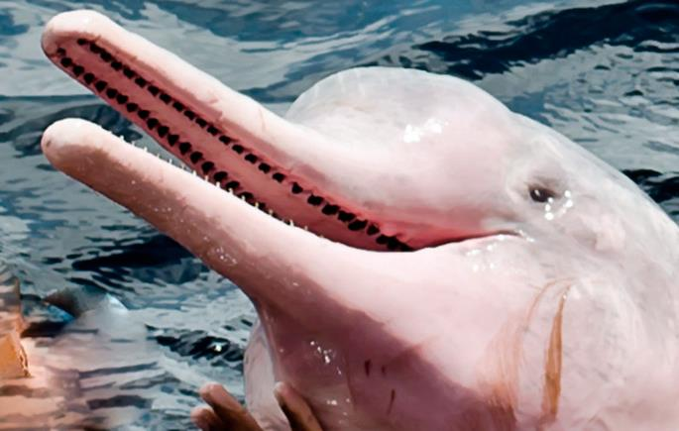
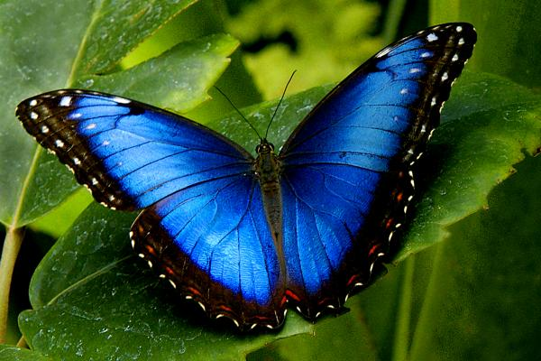
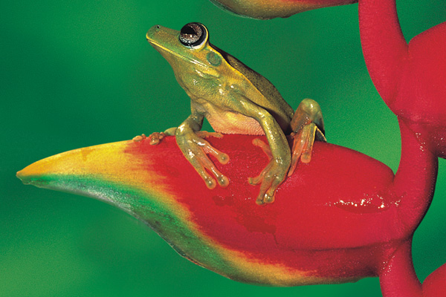
The beauty of rain forests
Notes:
Here’s a taste of what we are losing.

Slide 25
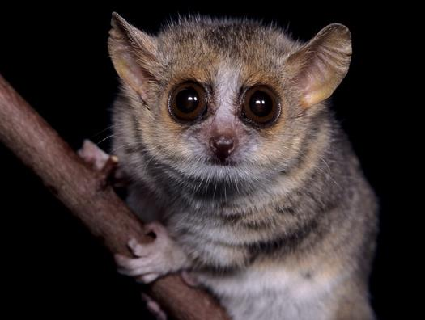
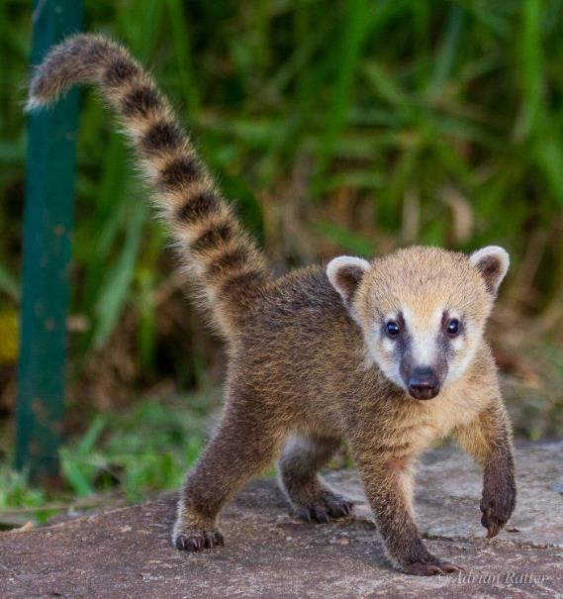
The beauty of rain forests

Slide 26
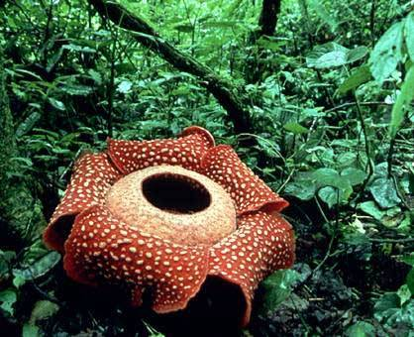
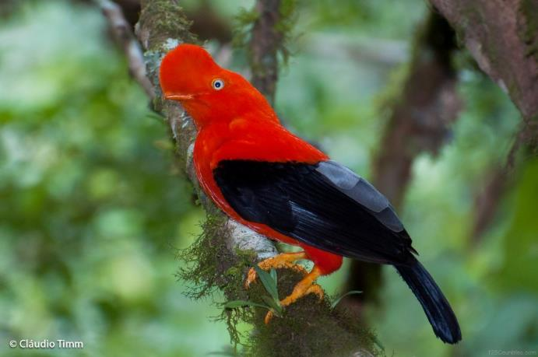
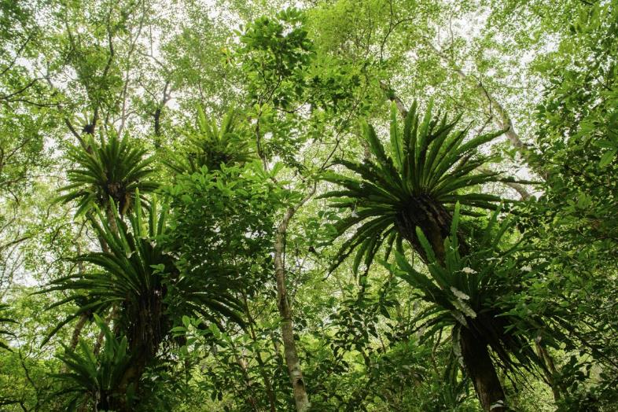
The beauty of rain forests
Notes:
https://www.youtube.com/watch?v=zbAuRzTko5A

Slide 27
The beauty of rainforests
Notes:
Vogelkop Superb Bird of Paradise, confirmed as a new species in 2018 (https://youtu.be/5jMTuuhTeqU)

Slide 28
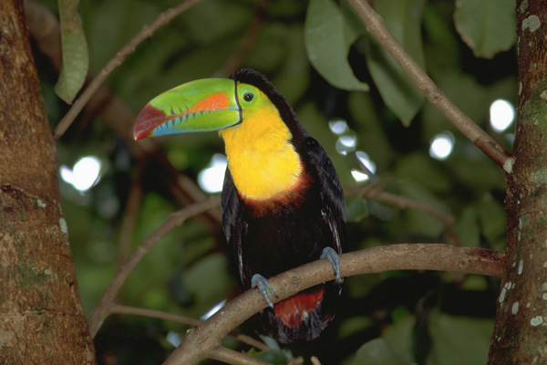
The beauty of rain forests

Slide 29
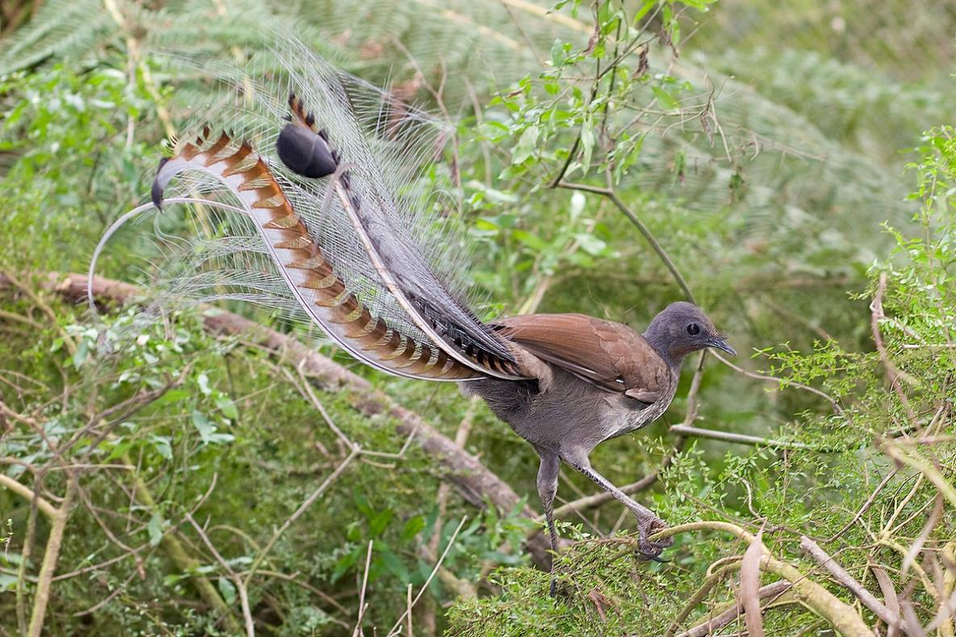
The beauty of rain forests
Notes:
Lyre bird (Australia)
https://www.youtube.com/watch?time_continue=13&v=mSB71jNq-yQ
https://www.youtube.com/watch?v=mSB71jNq-yQ
Or
https://www.youtube.com/watch?v=mXb04HkP8Iw
https://www.youtube.com/watch?v=mSB71jNq-yQ

Slide 30
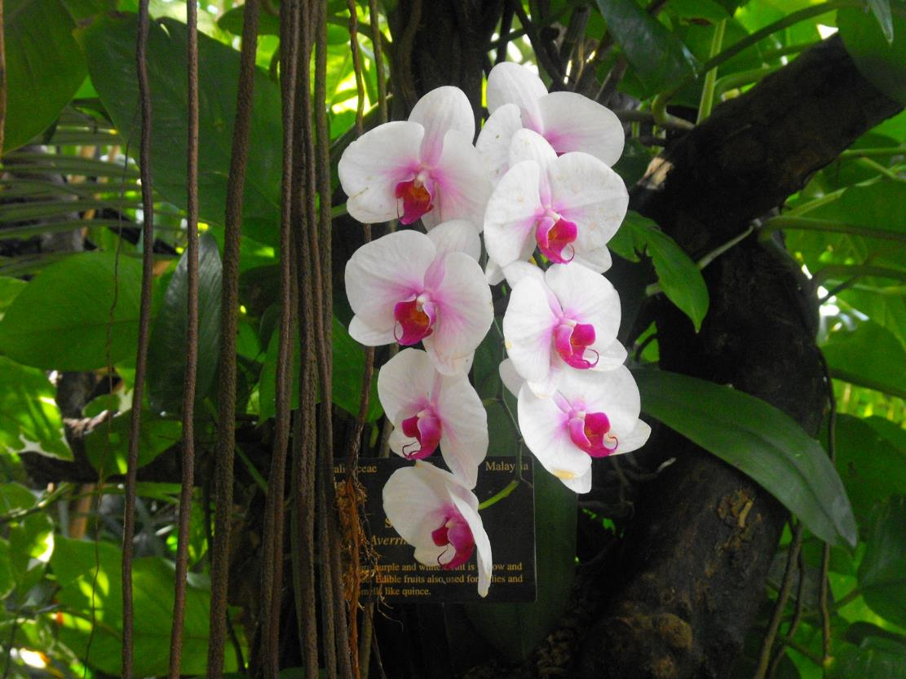
The beauty of rain forests
Notes:
There are over 28,000 species of orchid (twice as many as there are bird species!)

Slide 31
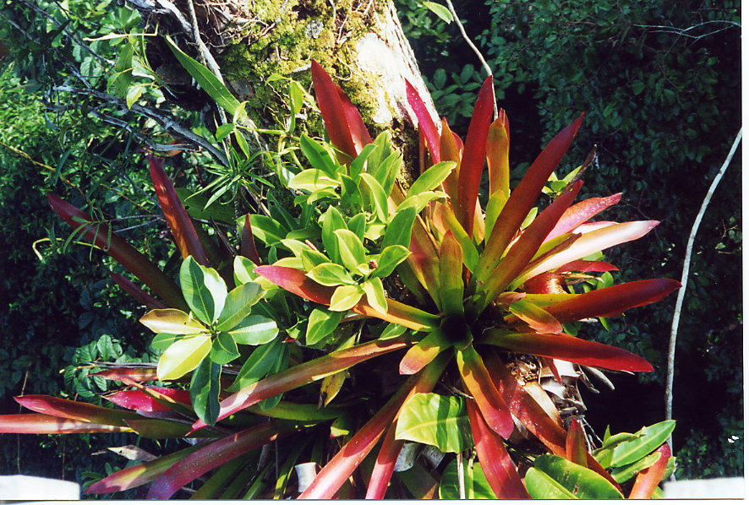
The beauty of rain forests

Slide 32
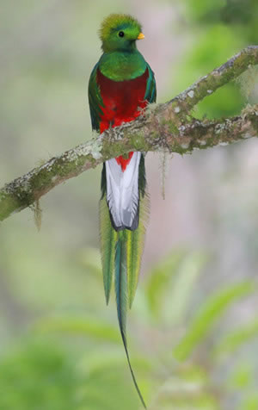
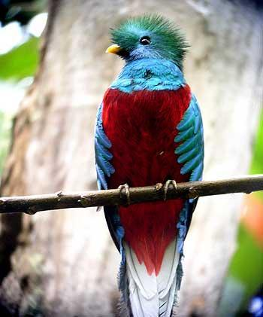
The beauty of rain forests

Slide 33
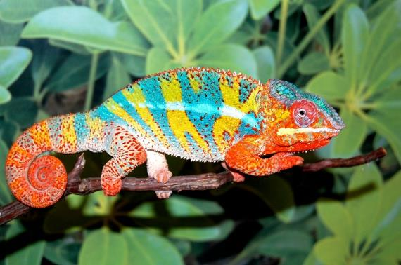
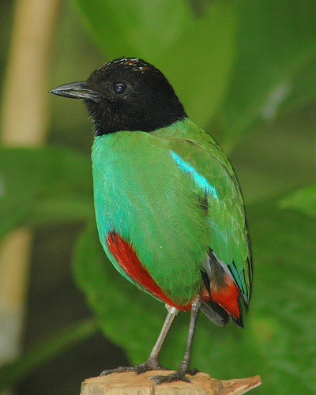
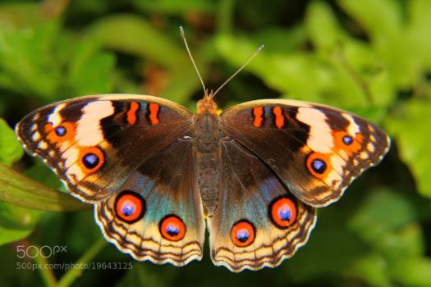
The beauty of rain forests

Slide 34
Plant pharmaceuticals
A huge number of our current medicines come from plants or are derived from plant chemicals
Rain forests have been called “God’s medicine chest”
It is certain countless drugs still await discovery
….unless the bulldozer gets there first
Notes:
And these forests aren’t just beautiful, and not “just” a central part of the weather systems that rule the planet … they are also irreplaceable for our health in another way.
Camptotheca acuminata; Pacific yew; Catharanthus roseus
Opium poppy; belladonna; Cinchona; Strychnos toxifera (tubocurarine)
Digitalis; coca plant; autumn crocus. Note that coral reefs too are under threat and are themselves sources of beauty; fish; new pharmaceuticals
On January 18, 2008, the Botanic Gardens Conservation International (representing botanic gardens in 120 countries) stated that "400 medicinal plants are at risk of extinction, from over-collection and deforestation, threatening the discovery of future cures for disease." These included Yew trees (the bark is used for cancer drugs, paclitaxel); Hoodia (from Namibia, source of weight loss drugs); half of Magnolias (used as Chinese medicine for 5,000 years to fight cancer, dementia and heart disease); and Autumn crocus (for gout). The group also found that 5 billion people benefit from traditional plant-based medicine for health care.

Slide 35
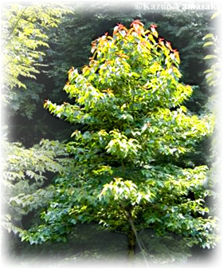
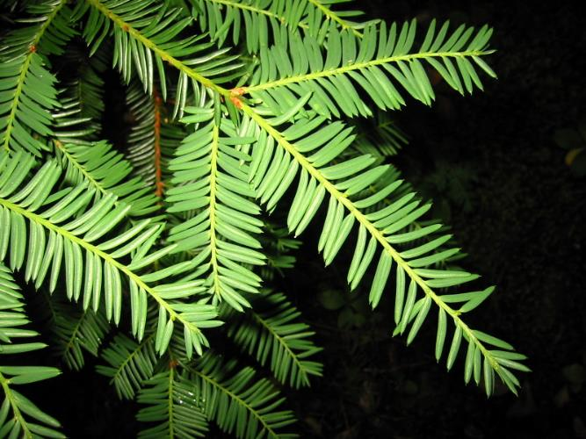
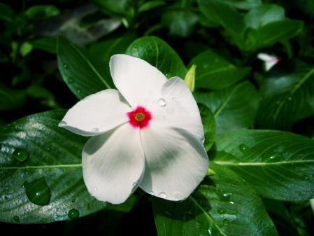
Plants against cancer
Notes:
Camptotheca acuminata - source of camptothecin, a drug to treat colorectal cancer;
Pacific yew – source of the ‘taxanes’, drugs against (amongst others) breast cancer;
Catharanthus roseus (Madagascar Periwinkle) – has revolutionized the treatment of childhood leukemias

Slide 36
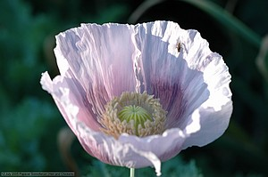
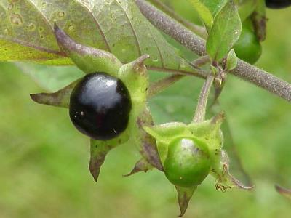
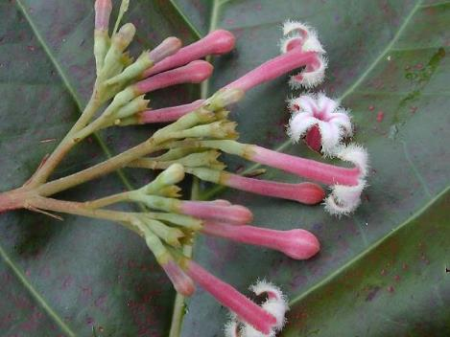
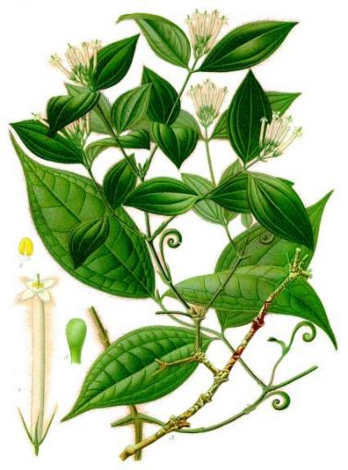
Other lifesaving plants
Notes:
Opium poppy; Deadly NIghtshade; Cinchona; Strychnos toxifera (tubocurarine)

Slide 37
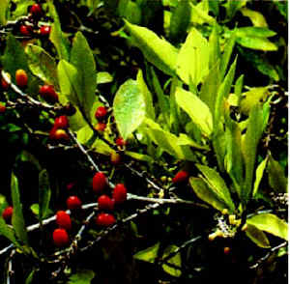
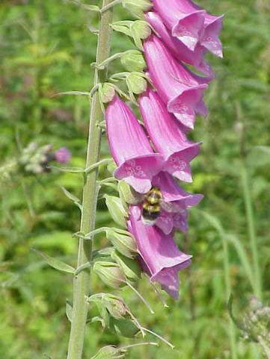
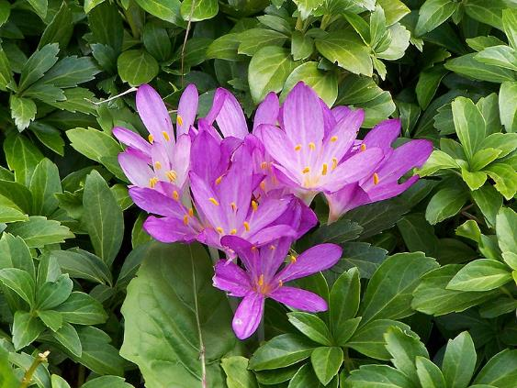
Other lifesaving plants
Notes:
Digitalis; coca plant; autumn crocus. (heart disease, cocaine-related painkillers, gout ….the last one also brand new as an anti-inflammatory against heart disease)

Slide 38
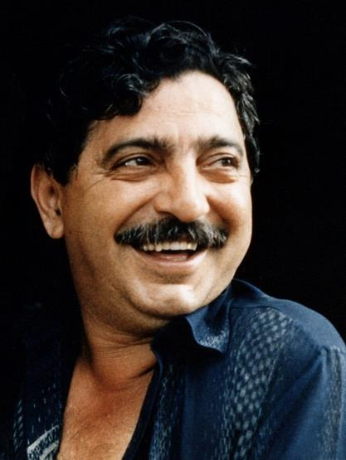
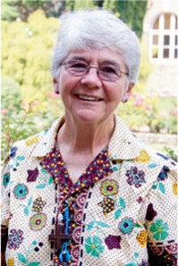
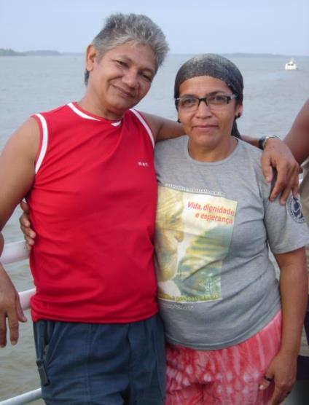
Human rights abuses
In 2020, according to Global Witness, 227 land and environmental defenders were murdered — an average of four people a week
Chico Mendes
(1944-1988)
Sister Dorothy Stang
(1931 – 2005)
Jose Claudio Ribeiro da Silva (1957 – 2011) and his wife Maria do Espirito Santo da Silva
Notes:
https://www.globalwitness.org/en/press-releases/global-witness-reports-227-land-and-environmental-activists-murdered-single-year-worst-figure-record/
Almost 2,000 land and environmental defenders killed between 2012 and 2022 for protecting the planet | Global Witness
Powerful interests are at work in the Brazilian rainforest, with repeated abuses of human rights.
Chico Mendes, defending rubber tree tappers; a Catholic nun, Dorothy Stang, campaigning for land rights; and Jose Claudio Ribeiro da Silva and his wife Maria do Espirito Santo da Silva, protesting illegal deforestation are just four of the many murdered for trying to protect the poor and the forest.
Human rights groups say violence is a usual way to settle land disputes in the Amazon.
Many people have been murdered, but their killers rarely go to jail
Chico Mendes, original name Francisco Alves Mendes, Jr., (born December 15, 1944, Xapuri, Acre, Brazil—died December 22, 1988, Xapuri), Brazilian labour leader and conservationist who defended the interests of the seringueiros, or rubber tree tappers, in the Amazonian state of Acre, calling for land reform and preservation of the Amazon Rainforest. His activism won him recognition throughout Brazil and internationally but also provoked the enmity of local ranchers, who eventually arranged his murder.
Sister Dorothy Stang was murdered by a rancher, Vitalmiro Bastos Moura, who resented her campaigning for land rights and to protect the forest - Dorothy Stang - Wikipedia
Ms Stang, who was 73 when she was killed (2005), worked in the Amazon for 30 years to preserve the rainforest and protect the rights of rural workers against large-scale farmers wanting to take their land.
She was shot dead as she walked along a muddy rainforest track in the town of Anapu in Para, a northern frontier state where loggers and ranchers have deforested huge tracts of rainforest.
The two confessed hitmen who killed her said Moura and another rancher still to be tried had paid them to do it.
"This conviction sends a strong message... that the impunity is ending," nun Rebecca Spires, who knew Ms Stang for 35 years, is quoted as saying by the Associated Press news agency.
https://www.ncronline.org/blogs/road-peace/sr-dorothy-stang-martyr-amazon
Father Jose Amaro was a colleague of Dorothy Stang and has been charged and imprisoned thanks to his campaign for land rights for peasants.
https://www.ncronline.org/news/environment/priest-contests-charges-related-efforts-help-amazons-landless?clickSource=email
Yet her killing wasn't an anomaly. In 2019, according to Global Witness, 212 land and environmental defenders were murdered — an average of four people a week
2011: Some activists such as Jose Claudio Ribeiro da Silva and his wife Maria do Espirito Santo da Silva were very vocal and outspoken on their views and activism. They often took part in international and local seminars on Amazon protection. Thus making themselves some enemies.
Jose was even once quoted saying: “I could be here today talking to you and in one month you will get the news that I disappeared. I will protect the forest at all costs. That is why I could get a bullet in my head at any moment … As long as I have the strength to walk, I will denounce all of those who damage the forest.”
In 2011, Jose and his wife were gunned down whilst riding their motorcycle from the nature reserve where they have worked for over two decades. Authorities believe that the gunmen were professional hired hit men. Both Jose and his wife’s ears were cut off, the ears are often used as a sign of proof to the people who ordered the killings that the murder has taken place.
At least 177 land and environmental defenders around the world were killed last year, taking the total number of defenders killed between 2012 and 2022 to 1,910, according to a new report by Global Witness
Almost nine in 10 recorded killings in 2022 were in Latin America, with more than a third of all fatal attacks taking place in Colombia – more than any other country
One in five murders of defenders worldwide took place in the Amazon Rainforest last year, with violence, torture and threats a shared reality for communities across the region
As well as lethal attacks, defenders are also being increasingly subject to criminalisation as a strategy for silencing those who speak out, with laws being weaponised against them

Slide 39
Oceans

Slide 40
Oceans, lakes, rivers
Oceans: using them sustainably
Preserving the beauty of coral reefs
Notes:
Like rainforests, oceans are of infinite benefit to humankind. As the Holy Father says (LS, #40), ‘Oceans not only contain the bulk of our planet’s water supply, but also most of the immense variety of living creatures, many of them still unknown to us and threatened for various reasons. What is more, marine life in rivers, lakes, seas and oceans, which feeds a great part of the world’s population, is affected by uncontrolled fishing, leading to a drastic depletion of certain species’.
‘In tropical and subtropical seas, we find coral reefs comparable to the great forests on dry land, for they shelter approximately a million species, including fish, crabs, molluscs, sponges and algae. Many of the world’s coral reefs are already barren or in a state of constant decline. “Who turned the wonderworld of the seas into underwater cemeteries bereft of colour and life?”’ (LS, #41)
#40. Oceans not only contain the bulk of our planet’s water supply, but also most of the immense variety of living creatures, many of them still unknown to us and threatened for various reasons. What is more, marine life in rivers, lakes, seas and oceans, which feeds a great part of the world’s population, is affected by uncontrolled fishing, leading to a drastic depletion of certain species. Selective forms of fishing which discard much of what they collect continue unabated. Particularly threatened are marine organisms which we tend to overlook, like some forms of plankton; they represent a significant element in the ocean food chain, and species used for our food ultimately depend on them.
41. In tropical and subtropical seas, we find coral reefs comparable to the great forests on dry land, for they shelter approximately a million species, including fish, crabs, molluscs, sponges and algae. Many of the world’s coral reefs are already barren or in a state of constant decline. “Who turned the wonderworld of the seas into underwater cemeteries bereft of colour and life?”
This phenomenon is due largely to pollution which reaches the sea as the result of deforestation, agricultural monocultures, industrial waste and destructive fishing methods, especially those using cyanide and dynamite. It is aggravated by the rise in temperature of the oceans. All of this helps us to see that every intervention in nature can have consequences which are not immediately evident, and that certain ways of exploiting resources prove costly in terms of degradation which ultimately reaches the ocean bed itself.
42. Greater investment needs to be made in research aimed at understanding more fully the functioning of ecosystems and adequately analyzing the different variables associated with any significant modification of the environment. Because all creatures are connected, each must be cherished with love and respect, for all of us as living creatures are dependent on one another. Each area is responsible for the care of this fam25 Catholic Bishops’ Conference of the Philippines, Pastoral Letter What is Happening to our Beautiful Land? (29 January 1988). This will require undertaking a careful inventory of the species which it hosts, with a view to developing programmes and strategies of protection with particular care for safeguarding species heading towards extinction..

Slide 41
Using oceans sustainably
Fish and shellfish form a significant part of the world's diet
But we are almost fished out
Personal action makes a difference
Be aware of what you’re eating and where it came from
Supporting sustainable fisheries helps people AND the environment
Notes:
Bad news:
Senegalese fishermen are being driven to suicidal boat trips to Europe as they have lost their livelihoods
Destroying mangroves to build shrimp farms led to a much greater damage in the Indian Ocean tsunami in December 2004.
Shrimp and fish farms use a lot of veterinary drugs and pesticides which cause pollution (as does the effluent from the concentrated populations of fish)
Over the next fifty years, if current trends continue, all currently fished species will be diminished to endangered levels
Good news
Wegmans offers sustainably farmed shrimp from Belize, and specializes in sustainably fished species.
Wal-Mart is enforcing strict rules on Thailand shrimp farms – they must replant three times the mangroves they destroy and clean up their effluent rather than have it discharge into the environment (Best Aquaculture Practices) – bapcertification.org

Slide 42
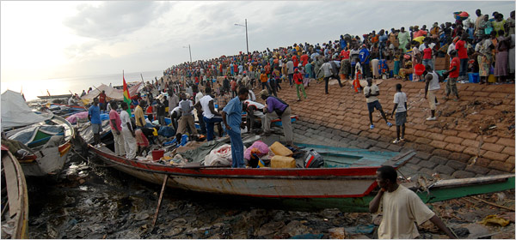
Overfishing’s tragic consequences
How is overfishing connected to migrants drowning trying to get to Europe?
Fishermen in Bissau, Guinea-Bissau; credit: Candace Feit for The New York Times
Notes:
Many West African fishermen are finding it impossible to find enough fish to live on. Factory ships from Europe, America and Asia (PRIMARILY China) have - essentially – vacuumed up all the fish that live there.
So more and more fishermen choose to take the very dangerous step of trying to get to Spanish-owned Canary Islands, off the coast of North Africa, as a gateway to Europe.
KAYAR, Senegal — Ale Nodye, the son and grandson of fishermen in this northern Senegalese village, said that for the past six years he netted barely enough fish to buy fuel for his boat. So he jumped at the chance for a new beginning. He volunteered to captain a wooden canoe full of 87 Africans to the Canary Islands in the hopes of making their way illegally to Europe.
The 2006 voyage ended badly. He and his passengers were arrested and deported. His cousin died on a similar mission not long afterward.
Nonetheless, Mr. Nodye, 27, said he intended to try again.
“I could be a fisherman there,” he said. “Life is better there. There are no fish in the sea here anymore.”
https://www.nytimes.com/2008/01/14/world/africa/14fishing.html
Picture: Fishermen in Bissau, Guinea-Bissau. Overfishing has depleted once-bountiful African waters. Credit Candace Feit for The New York Times

Slide 43
Coral reefs
The 'marine rainforests'
This Photo by Unknown Author is licensed under CC BY
Notes:
NOAA Coral Reef Conservation Program - The Coral Reef Conservation Program Celebrates 20 Years
Coral reef ecosystems sustain and protect lives, livelihoods, and coastal property. They support recreational fishing and diving, commercial fishing, and pharmaceutical research, and provide protection from waves and flooding. Each year, coral reefs pump more than $3.4 billion into the U.S. economy.
Coral reefs are threatened by stressors that include land-based sources of pollution, unsustainable fishing practices, and a changing climate. As a result, more than 25 percent of the world’s coral reefs have been lost in the last three decades. There are 22 coral species listed as threatened and three species listed as endangered under the Endangered Species Act.
Yet it’s not too late to save coral reefs. Scientists and conservationists are studying reefs, as well as the most effective ways to reduce the impacts of pollution, unsustainable fishing, climate change, and other threats. Active restoration often helps give coral reefs time to recover from stressors. Through these efforts, corals can continue to prosper for present and future generations.
Now looking specifically at coral reefs, which are – as it says here – as intricate an ecosystem as the rainforest, just as important, and just as endangered.

Slide 44
Coral reefs …
… are (again) beautiful and indispensable
Essential fish nurseries and source of pharmaceuticals
Notes:
Not only are reefs the spawning grounds and nurseries for lots of species of fish (that we eat) - - the new antibiotics and anti-cancer drugs found in coral reef organisms are just as unexpected as any found on dry land or in the lab.

Slide 45
Notes:
And reefs are wonderful places.

Slide 49
Coral reefs are in trouble
Runoff of polluted water
Overfishing
Acidification from increased CO₂ in the atmosphere
Bleaching due to high temperatures
Notes:
Since the beginning of the Industrial Revolution, the acidity of surface ocean waters has increased by about 30%.^{13,14} This increase is the result of humans emitting more carbon dioxide into the atmosphere and hence more being absorbed into the ocean. The ocean has absorbed between 20% and 30% of total anthropogenic carbon dioxide emissions in recent decades (7.2 to 10.8 billion metric tons per year).^{15,1}
https://climate.nasa.gov/evidence/
13. http://www.pmel.noaa.gov/co2/story/What+is+Ocean+Acidification%3F
14. http://www.pmel.noaa.gov/co2/story/Ocean+Acidification
15. C. L. Sabine et.al., “The Oceanic Sink for Anthropogenic CO₂,” Science vol. 305 (16 July 2004), 367-371

Slide 51
“Who turned the wonderworld of the seas into underwater cemeteries bereft of color and life?”
Notes:
Quote from Laudato Si’. #40.
“Who turned the wonderworld of the seas into underwater cemeteries bereft of colour and life?” [Catholic Bishops’ Conference of the Philippines, Pastoral Letter What is Happening to our Beautiful Land? (29 January 1988).
#40. Oceans not only contain the bulk of our planet’s water supply, but also most of the immense variety of living creatures, many of them still unknown to us and threatened for various reasons. What is more, marine life in rivers, lakes, seas and oceans, which feeds a great part of the world’s population, is affected by uncontrolled fishing, leading to a drastic depletion of certain species. Selective forms of fishing which discard much of what they collect continue unabated. Particularly threatened are marine organisms which we tend to overlook, like some forms of plankton; they represent a significant element in the ocean food chain, and species used for our food ultimately depend on them. 30 41. In tropical and subtropical seas, we find coral reefs comparable to the great forests on dry land, for they shelter approximately a million species, including fish, crabs, molluscs, sponges and algae. Many of the world’s coral reefs are already barren or in a state of constant decline. “Who turned the wonderworld of the seas into underwater cemeteries bereft of colour and life?” [Catholic Bishops’ Conference of the Philippines, Pastoral Letter What is Happening to our Beautiful Land? (29 January 1988).
This phenomenon is due largely to pollution which reaches the sea as the result of deforestation, agricultural monocultures, industrial waste and destructive fishing methods, especially those using cyanide and dynamite. It is aggravated by the rise in temperature of the oceans. All of this helps us to see that every intervention in nature can have consequences which are not immediately evident, and that certain ways of exploiting resources prove costly in terms of degradation which ultimately reaches the ocean bed itself. 42. Greater investment needs to be made in research aimed at understanding more fully the functioning of ecosystems and adequately analyzing the different variables associated with any significant modification of the environment. Because all creatures are connected, each must be cherished with love and respect, for all of us as living creatures are dependent on one another. Each area is responsible for the care of this fam25 Catholic Bishops’ Conference of the Philippines, Pastoral Letter What is Happening to our Beautiful Land? (29 January 1988). 31 ily. This will require undertaking a careful inventory of the species which it hosts, with a view to developing programmes and strategies of protection with particular care for safeguarding species heading towards extinction..

Slide 52
Closer to home: bird populations
Across the American continent, bird numbers have plummeted – even among common species
In less than a single lifetime, North America has lost more than one in four of its birds, according to a report in the world’s leading scientific journal, Science
Notes:
https://www.3billionbirds.org/
The losses include iconic songsters such as Eastern and Western Meadowlarks (down by 139 million) and favorite birds at feeders, such as Dark-eyed Juncos (down by 168 million) and White-throated Sparrows (down by 93 million).
Biodiversity loss is NOT JUST big important animals in the tropics!

Slide 53
Closer to home: bird populations
Researchers at seven institutions found that 2.9 billion breeding adult birds have been lost since 1970, in every ecosystem.
The disappearance of even common species indicates a shift in our ecosystems’ ability to support basic birdlife
Notes:
https://www.3billionbirds.org/
By ‘every ecosystem’ we mean farmland, seashore, forests, etc.
The losses include iconic songsters such as Eastern and Western Meadowlarks (down by 139 million) and favorite birds at feeders, such as Dark-eyed Juncos (down by 168 million) and White-throated Sparrows (down by 93 million).
Biodiversity loss is NOT JUST big important animals in the tropics!

Slide 54
Birds are getting squeezed
Their habitat is being built on
Windows and skyscrapers act like bird magnets – millions die each year
Insecticides have far-reaching effects:
Direct poisoning
Insects (their food) are being poisoned out of existence, so birds are starving
Notes:
Background information:
It is not just birds that are affected- - - - -
Terrestrial vertebrate population sizes and ranges have contracted by one-third, and many mammals have experienced range declines of at least 80% over the last century (G. Ceballos, P. R. Ehrlich, R. Dirzo, Biological annihilation via the ongoing sixth mass extinction signaled by vertebrate population losses and declines.
Proc. Natl. Acad. Sci. U.S.A. 114, E6089–E6096 (2017).).
A 2019 assessment suggests that half of all amphibians are imperiled (2.5% of which have recently gone extinct)
(P. Gonza´ lez-Del-Pliego et al., Phylogenetic and trait-based prediction of extinction risk for data-deficient amphibians. Curr. Biol. 29, 1557–1563.e3 (2019).).

Slide 55
The Reality of the Insect Apocalypse and What We Can Do
Notes:
https://xerces.org/blog/insect-apocalypse-what-is-really-happening-why-it-matters-and-how-we-all-can-help
(Scott Hoffman Black, Exec Director, Xerces Society)
“We have removed, degraded, or fragmented habitat in agricultural areas as well as in towns and cities. Less habitat means less diversity of species and less abundance of those that survive: it is as simple as that. Add in the toxic chemicals that are widely used—from the herbicides and insecticides employed in growing corn, soybeans, and many other crops, to the many pesticides applied in the quest for weed-free lawns and perfect-looking roses—and even the habitats that do remain often have pesticide residues that can profoundly impact insects. There are additional negative consequences from invasive plants and animals, globally distributed diseases of bumble bees and other insects, poor water quality and quantity that imperil stoneflies and other aquatic invertebrates, and lights that are disruptive to such nocturnal insects as fireflies and moths. Overlay all of this with the increase in severe weather events and shifting rainfall patterns that are caused by climate change, and you can see that it is hard to be an insect in this human-dominated world.”

Slide 56
Insect apocalypse: facts and figures
Bumblebees: 28% of species in North America are threatened; 24% in Europe.
Butterflies (Ohio): one-third ‘biomass’ (population abundance) lost over 21 years
Butterflies (Northern California): populations have decreased for the last 45 years
Notes:
The evidence is clear that we are losing insects at an alarming rate. Among bumble bees, 28 percent of species in North America are considered threatened; 41 percent in Mesoamerica; and 23.5 percent in Europe. Among butterflies, ten-year trends in the United Kingdom show that 52 percent of species have declined in abundance at monitored sites and the geographic ranges of 47 percent of species are reduced. A monitoring program in Belgium showed that nineteen of the sixty-four butterfly species indigenous to the Flanders region have been extirpated and no longer occur there. European invertebrate species whose population trends have been evaluated show a high proportion in decline, and a far smaller fraction increasing. Assessments in North America show similar trends: NatureServe
Although fewer than 1 percent of described invertebrate species have been assessed for threats by the International Union for Conservation of Nature, approximately 40 percent of all those that have been assessed are considered threatened. In addition to losses in invertebrate species and distributions, reductions in total insect biomass are being reported from long-term studies done in many parts of the globe:
Ohio, USA: A 33-percent reduction in the abundance of butterflies was observed over twenty-one years of extensive monitoring.
California, USA: Monitoring done at sites across northern California from sea level to mountains over a forty-five-year period found that abundance is declining in all groups of butterflies.
Costa Rica: Repeated surveys in a protected forest have found declines in entire genera of tropical moths.
Germany: The total biomass of flying insects decreased by more than 70 percent across sixty-three study locations over twenty-seven years.

Slide 57
Insect apocalypse: facts and figures
Butterflies (UK): Half the species have declined in abundance and half are less widespread
Butterflies (Belgium): 30% of Flanders species extinct
Germany: The total biomass of flying insects decreased by more than 70 percent across sixty-three study locations over twenty-seven years.
The road trip’s insect splatter is no longer seen
Notes:
The evidence is clear that we are losing insects at an alarming rate. Among bumble bees, 28 percent of species in North America are considered threatened; 41 percent in Mesoamerica; and 23.5 percent in Europe. Among butterflies, ten-year trends in the United Kingdom show that 52 percent of species have declined in abundance at monitored sites and the geographic ranges of 47 percent of species are reduced. A monitoring program in Belgium showed that nineteen of the sixty-four butterfly species indigenous to the Flanders region have been extirpated and no longer occur there. European invertebrate species whose population trends have been evaluated show a high proportion in decline, and a far smaller fraction increasing. Assessments in North America show similar trends: NatureServe
Although fewer than 1 percent of described invertebrate species have been assessed for threats by the International Union for Conservation of Nature, approximately 40 percent of all those that have been assessed are considered threatened. In addition to losses in invertebrate species and distributions, reductions in total insect biomass are being reported from long-term studies done in many parts of the globe:
Ohio, USA: A 33-percent reduction in the abundance of butterflies was observed over twenty-one years of extensive monitoring.
California, USA: Monitoring done at sites across northern California from sea level to mountains over a forty-five-year period found that abundance is declining in all groups of butterflies.
Costa Rica: Repeated surveys in a protected forest have found declines in entire genera of tropical moths.
Germany: The total biomass of flying insects decreased by more than 70 percent across sixty-three study locations over twenty-seven years.
Anecdotal evidence (from Scott Black, Executive Director of Xerces Society): This summer, I visited America’s heartland, the agricultural states of Nebraska and Iowa. My trip was for both pleasure and work—seeing family in Nebraska, where I grew up, and then taking part in a farm tour in Iowa, where I was presenting an overview of the many threats to insects and the strategies for their conservation. Driving across eastern Nebraska and western Iowa with my son Theo to attend the farm tour in Grinnell one morning in July, the enormity of the impact we are having on the planet was brought home to me. Forty years ago I remember the rolling hills along the Missouri River covered with trees and, in the flatter areas between Lincoln and Omaha, a variety of crops, including sorghum and corn, growing in relatively small fields. Back then the sea of corn and soybeans did not start until you were into Iowa and well east of the Missouri River. All of that has changed. As we drove east from Lincoln almost every available space was corn or soybeans, giant fields stretching to the horizon. On the outskirts of Omaha, corn grew right up to the parking lot of a sprawling shopping mall. Even the steeper hills in the bluffs east of the river are now corn. Combine that with the urban sprawl from Omaha and Lincoln and it is easy to understand why we are seeing declining populations of insects, birds, and other animals. Wild creatures simply have fewer places to live, and all wildlife has to contend with the multiple poisons that humans use in both urban and rural areas. When we arrived at Grinnell Heritage Farm the loss of insects was already on people’s minds. Before I spoke, one farm visitor commented that “driving across Iowa you rarely see insects get smashed on the windshield anymore.” This is not an isolated observation. Many scientists from the United States and Europe have noted how few insects are splattered on the fronts of cars compared with the profusion that they remember from when they were growing up. As a young man in Nebraska, my pride and joy was a 1971 Mach 1 Mustang, which I had to wash weekly to keep it clean and shiny. For many of us it seems as though there are now far fewer insects to clean off of our cars after a long trip. Indeed, the windshield of my rental car was clean following that morning’s drive. But memories vary, and we really cannot rely on anecdotes of the “windshield effect” as we seek to understand long-term wildlife trends.

Slide 58
The apocalypse is real
Insects are fundamental for the working of a viable planet
This must not be ignored
We all need to act
Notes:
So what do we do to encourage robust populations of diverse native insects? We need high-quality, climate-resilient habitat across the landscape. Government agencies, farmers, managers of natural areas, homeowners, and businesses all can protect and restore habitat, reduce the harm of pesticides on nontarget insects, and undertake actions to help slow climate change.
In my line of work, it is easy to become discouraged. The issues are large and sometimes the solutions seem too small. But I believe that there is hope. Although the evidence certainly shows that insects are declining in abundance, diversity, and biomass, studies also demonstrate that if we protect, restore, and enhance habitat and eliminate pesticides, then insects rebound. Research on a site in the United Kingdom showed that restoration led to a threefold increase in the numbers of a butterfly there. Similar studies in the United States show that hedgerow habitat on farms leads to greater diversity and abundance of bees and, over time, helps not just generalist bees but also those that are less common. Removal of invasive plants from streams and wetlands has been shown to improve habitat for dragonflies and damselflies. And protection and restoration of the habitat of a variety of rare insects has led to increases in their population sizes.

Slide 59
Tackling the insect apocalypse
We need high-quality, climate-resilient habitat across the landscape
That’s a task for all of us
Government agencies, farmers, managers of natural areas, homeowners, and businesses/employers … all can protect and restore habitat, reduce the harm of pesticides on nontarget insects, and undertake actions to help slow climate change.
These ‘remedial’ interventions do work.
Notes:
So what do we do to encourage robust populations of diverse native insects? We need high-quality, climate-resilient habitat across the landscape. Government agencies, farmers, managers of natural areas, homeowners, and businesses all can protect and restore habitat, reduce the harm of pesticides on nontarget insects, and undertake actions to help slow climate change.
In my line of work, it is easy to become discouraged. The issues are large and sometimes the solutions seem too small. But I believe that there is hope. Although the evidence certainly shows that insects are declining in abundance, diversity, and biomass, studies also demonstrate that if we protect, restore, and enhance habitat and eliminate pesticides, then insects rebound. Research on a site in the United Kingdom showed that restoration led to a threefold increase in the numbers of a butterfly there. Similar studies in the United States show that hedgerow habitat on farms leads to greater diversity and abundance of bees and, over time, helps not just generalist bees but also those that are less common. Removal of invasive plants from streams and wetlands has been shown to improve habitat for dragonflies and damselflies. And protection and restoration of the habitat of a variety of rare insects has led to increases in their population sizes.

Slide 60
But surely …
Notes:
Ah we have an objection at the back of the audience!

Slide 61
But surely……
Why should we care about a useless little fish or weed, like the snail darter or Furbish lousewort?
Notes:
Snail darter – small snail-eating fish, thought to be endangered at one point and whose rarity almost threatened the opening of a dam.
Furbish lousewort – a small yellow flower, again, mixed up with a proposed dam. And this one really is very rare (New Brunswick).

Slide 62
Useless species?
Why should we care about a useless little fish or weed, like the snail darter or Furbish lousewort?
Because the natural world is made up of wild species providing us (for free) with services that can be very expensive or impossible for us to do ourselves
Earthworms, fungi, bees, vultures, plants
Notes:
Jared Diamond’s text. (page 489, “Collapse”)
They help with:
Earthworms – recycling plant remains and oxygenating the soil
Soil bacteria and fungi (nitrogen fixation, forests, crops)
Bees pollinating
Fungi and insects and other minibeasts recycle dead animals, wood and so on - everywhere [note these first four are all ‘small, insignificant’ species]
Vultures vs rabid dogs
Providing structure to the ecosystem (if top predators like wolves and whales are removed then there are incalculable effects in the rest of the ecosystem”
Providing medicines from the sea and the rain forest

Slide 63
Useless species?
Elimination of lots of “lousy little creatures” regularly causes big harmful consequences for us humans
Just as would the random removal of the “lousy little rivets” holding together an airplane
Notes:
Jared Diamond’s text. (page 489, “Collapse”)

Slide 64
Useless species?
Remember… when we kill off a species we go against God’s dual blessings:
We cancel the life God gave to the species
We forever lose the benefits that species has for humanity
When we ignore a blessing, we disrespect God
Notes:
Always come back to this – it is a sin to knowingly annihilate a species (however “useful” **or** “useless”)

Slide 65
How can I make any difference?
“Faced as we are
with global environmental deterioration,
I wish to address
every person living on this planet...”
(Pope Francis, Laudato Si’ #3)

Slide 66
Our back yard
Try perennials and native plants
wildflower.org
www.audubon.org/native-plants
plantnative.org
plants.usda.gov
Long-lasting, tailored to thrive in your environment, and home to lots of animals
Notes:
Perennials expand on their own – save a lot of money and time
Native plants are better for wildlife and hardly ever need any watering
Depending on your area, they will include plants such as Echinacea, Rudbeckia, Columbines, bee balm, evening primrose, Phlox, Lobelia, native honeysuckles, Asters, golden-rod, Gaillardia, Verbena, Coreopsis, Scabious, Milkweeds, Penstemon and Hibiscus.
Favor single-flowered varieties, rather than frilly ‘double’ ones, which tend to be less attractive to insects.
Where possible, choose plants that grow naturally where you live. Native plants are much the best for all manner of wildlife and will tough out the harshest winter and driest summer. A lot of them will serve as food plants for caterpillars (e.g., milkweeds for the Monarch butterfly) …don’t forget, no food plants = no moths or butterflies.
Research what is best for your area by visiting the Lady Bird Johnson Wildflower Center website, http://www.wildflower.org; other useful sites include http://www.plantnative.org, and http://plants.usda.gov )

Slide 67
Perennials and native plants

Slide 68
Perennials and native plants
Notes:
Perennials expand on their own – save a lot of money and time
Native plants are better for wildlife and hardly ever need any watering
… but annual pollinators like Zinnias are marvelous as well

Slide 69
Perennials and native plants
Notes:
Perennials expand on their own – save a lot of money and time
Native plants are better for wildlife and hardly ever need any watering

Slide 70
Pollinators
Bees and butterflies are in steep decline
Ecological and financial consequences are huge
We can all help
Avoid using pesticides
Use pollinator-friendly plants and also encourage caterpillar food plants
Notes:
Insects are the biggest group of pollinators. The champions are bees (honey, bumble and native), and the Lepidoptera (butterflies and moths). Beetles and flies are important too.
It is difficult for us to comprehend the debt that we owe to these insects. The great majority of our crops and the world’s flowering plants are completely dependent on their activities. Without them, we wouldn’t have a lot to eat! An intelligent guesstimate is that pollinator services are worth $3 billion a year to the United States alone.
Yet in North America, many pollinator species are becoming much less common than they used to be, affected as they are by insecticides targeting ‘pest’ insects; by reductions in, and deterioration of, their habitat; and diseases introduced from the Old World. Even the honey bee, introduced here and used extensively to pollinate crops such as almond trees, is in trouble.
This is disastrous for nature and for us – who doesn’t want to see more butterflies?
“Pollinators are responsible for 1 out of 3 bites of food we take each day, and yet pollinators are at critical point in their own survival. Many reasons contribute to their recent decline. We know for certain, however, that more nectar and pollen sources provided by more flowering plants and trees will help improve their health and numbers. Increasing the number of pollinator-friendly gardens and landscapes will help revive the health of bees, butterflies, birds, bats and other pollinators across the country.” (http://millionpollinatorgardens.org/)
It is considered by many scientists and conservationists that declining populations of bees (including honeybees) and butterflies are caused by direct and indirect poisoning by the commonly-used “neonicotinoid” insecticides, and by the continuing downward trend in the number and variety of food plants for caterpillars and pollen/nectar-rich flowers.
https://www.xerces.org/publications/scientific-reports/how-neonicotinoids-can-kill-bees
What are neonicotinoids? The name means new chemicals that resemble nicotine (itself a very powerful insecticide, but too dangerous for normal use). They are used very extensively on farms and by townships, and until recently were thought of as fairly benign pesticides, with little danger of poisoning mammals and birds. However, it is now clear that plants treated with neonicotinoids not only absorb the insecticide into their tissues – the way the chemical is meant to work – but they also allow nectar and pollen to become infused with the pesticide. This either kills pollinating insects immediately, or (at lower doses) confuses the insects – it has been observed that honeybees have problems navigating whether exposed to not-quite-lethal doses of “neonics” as a larva or as an adult. Bumblebees and other native bees have similar vulnerabilities, even at minimal doses.
Neonicotinoids also hang around in the environment for months and years, so early application, a long time before flowers appear, won’t necessarily help avoid killing beneficial insects. There is a lot of research going on to learn more about these harmful effects, and certain countries and US states have severely curtailed the use of these insecticides.
https://www.xerces.org/sites/default/files/2018-05/16-023_01_XercesSoc_ExecSummary_How-Neonicotinoids-Can-Kill-Bees_web.pdf
The problems go up the food chain too. Compelling evidence exists that bird populations are in general decline because of reduced inset populations. As an example, a group of Dutch scientists found that insect-eating bird populations had started declining following the introduction onto the market of a neonicotinoid pesticide imidacloprid, and that the more of this chemical that was detectable in surface water (lakes, rivers), the more the bird populations went down. After all – fewer insects, fewer baby birds.
https://pubmed.ncbi.nlm.nih.gov/25030173/
To top it all, new evidence suggests that doses of these pesticides that don’t kill a bird directly can, nevertheless, upset their migratory sense of direction.
https://www.audubon.org/magazine/spring-2017/the-same-pesticides-linked-bee-declines-might
As individuals, we can keep ourselves informed about the use of insecticides in our township parks and on our farms. Yet more directly of benefit to pollinators – and to birds, and to us – will be creating spaces for these crucially important insects in our backyards; places for them to rest, nest and feed.

Slide 71
Notes:
https://www.theguardian.com/world/2018/mar/21/catastrophe-as-frances-bird-population-collapses-due-to-pesticides
Also - - - A recent study from the USA found that migrating White-crowned Sparrows Zonotrichia leucophrys exposed to neonicotinoids lost a quarter of their body mass and fat stores.

Slide 72
Notes:
http://www.birdlife.org/worldwide/news/even-familiar-birds-risk-extinction-new-study-finds?utm_source=sidebar&utm_medium=topnews

Slide 73
What we eat and don’t eat makes a difference
Low on the food chain = less energy & water used
1 lb. lentils vs. 1 lb beef
http://www.waterfootprint.org
If you can, buy organic
Primarily to reduce pesticides in the environment
If you can, buy local
Reduce ‘food miles’
Notes:
Household usage of water is dwarfed by the effects that our consumer lifestyle and our diet have on water use. As an example, it takes 1, 857 gallons of water to raise one pound of beef and 469 gallons to raise a pound of chicken (vs. only 43 gallons to grow a pound of beans)….. and a pair of jeans takes 2,900 gallons of water to make.
This water will usually all be drinking-quality water.
Visit http://www.waterfootprint.org/ to learn more. There, you can calculate your own ‘water footprint’
.
These facts shouldn’t necessarily make us feel guilty: instead, they should make us appreciate the gift of life that water constitutes, and conserve it when we can.

Slide 74
What we eat and don’t eat makes a difference
Watch what fish you choose
Sustainable fish stocks mean long-term benefits to the fishermen and the planet
Look for Marine Stewardship Council certification
Download the guide - http://www.seafoodwatch.org/
Notes:
http://www.msc.org/
If you eat fish that was caught sustainably, you know you are conserving God’s creation and helping feed someone’s family.
If you eat fish that has harvested unsustainably, you are not only driving that species towards extinction – you are quite likely to be depriving someone poorer than yourself of a livelihood.
Farmed salmon and shrimp are to be avoided. Salmon farms cause extensive local pollution in sea lochs in Scotland and elsewhere, as well as having other deleterious environmental effects. Third World shrimp farms not only pollute, they are often created by cutting down mangroves or destroying coral reefs – a seriously un-green thing to do!
“In the ocean, fish are often grown in open net pens, packed together more tightly than in nature. Disease can spread quickly through a captive school and even endanger wild fish in the surrounding ocean. Most troubling, many farmed fish (like salmon) consume more wild fish — ground up into fishmeal — than they produce as farmed product, defeating the very purpose of aquaculture.
“Unless we develop strong and enforceable regulations to control fish farming, it may wreak havoc on some of our wild fish supply. The real challenge lies not in banning farming fish altogether but in finding smart solutions that deliver a safe and environmentally acceptable seafood supply…”
Ocean Conservancy

Slide 75
What we eat and don’t eat makes a difference
The food we waste is a disaster for the planet
1.3 billion tons of food lost or wasted worldwide
That’s one-third!
40% in this country, when 42 million Americans say they don’t have enough to eat
It has been estimated that this wasted food accounts for a quarter of the world’s deforestation and a quarter of our global water use

Slide 76
The food we waste is a disaster for the planet
At the growers & elsewhere in the supply chain
One study of on-farm losses:
40% of tomatoes are discarded
Over half of the leafy greens
One-third of peaches
Then another 14% of peaches lost at the packing houses
Then the retailers waste over $18 billion each year (sell-by dates, odd-looking fruit, etc.)
Notes:
WWF MAGAZINE FALL 2018 vol 6 number 3
Studies Floridian tomatoes, Arizonan greens, NJ peaches

Slide 77
The food we waste is a disaster for the planet
Elsewhere:
In school cafeterias
In hotels and restaurants (2-4 million tons wasted)
In our own homes

Slide 78
What we drink makes a difference
Drink wine with corks!
Look for organically grown grapes

Slide 79
What we drink makes a difference
Try to buy shade-grown coffee
The coffee bushes are grown in the rainforest, leaving it intact!
Examples are …
Birds & Beans (http://www.birdsandbeans.com/)
Gevalia and other brands available in supermarkets

Slide 80
Protecting rainforests
Never use endangered wood if you can avoid doing so
Look for Forest Stewardship Council certification
Contribute to the Rainforest Trust
www.rainforesttrust.org
Notes:
Find out more:
http://fscus.org/
www.rainforesttrust.org

Slide 81
EcoPhilly.org

